Slide 1
Ocean Shipping Reform Act of 2022 (OSRA 22) Overview Webinar
Delivered by the Office of Data Development and Standards,
Bureau of Transportation Statistics
January 17, 2023

Slide 2
Bureau of Transportation Statistics (BTS)
BTS is a part of the Department of Transportation (DOT), as well as one of the 13 federal statistical agencies. It is the preeminent source of statistics on commercial aviation, multimodal freight activity, and transportation economics, and provides context to decision makers and the public for understanding statistics on transportation.
BTS assures the credibility of its products and services through rigorous analysis, transparent data quality, and independence from political influence.
BTS promotes innovative methods of data collection, analysis, visualization, and dissemination to improve operational efficiency, to examine emerging topics, and to create relevant and timely information products that foster understanding of transportation and its transformational role in society.

Slide 3
Key OSRA Personnel
Office of Data Development and Standards (ODDS)
Cha-Chi Fan, Ph.D., Office Director
April Gadsby, Ph.D., Mathematical Statistician
Janine McFadden, Senior Survey Statistician, OSRA Project Manager
Clara Reschovsky, Senior Survey Statistician, Confidentiality Officer
Office of Transportation Analysis (OTA)
Matthew Chambers, Senior Transportation Analyst
April Taylor, Senior Freight Specialist (on detail from the Economic Research Service at the United States Department of Agriculture)

Slide 4
Agenda
Part I: An overview on the Ocean Shipping Reform Act of 2022
What is OSRA 22?
What organizations are required to participate?
What is required of my company to respond?
How does my organization submit information to meet the mandate?
Part II: Data collection and publication process
How does BTS work with the data received?
How does BTS calculate Street Dwell Time and the Out of Service Rates?
What will the final product look like?
How will BTS keep data secure and confidential?

Slide 5
Ocean Shipping Reform Act of 2022
Background
June 16, 2022, the Ocean Shipping Reform Act of 2022 was passed into law by Congress. The bill revises the requirements governing ocean shipping, with the objective of improving efficiency, competitiveness, and economy of the Nation's ocean transportation system. The act aims to promote growth and development of U.S. exports by leveling the playing field for domestic shippers.
Section 16
Section 16 of the bill directs BTS to collect street dwell time and out of service percentage data.

Slide 6
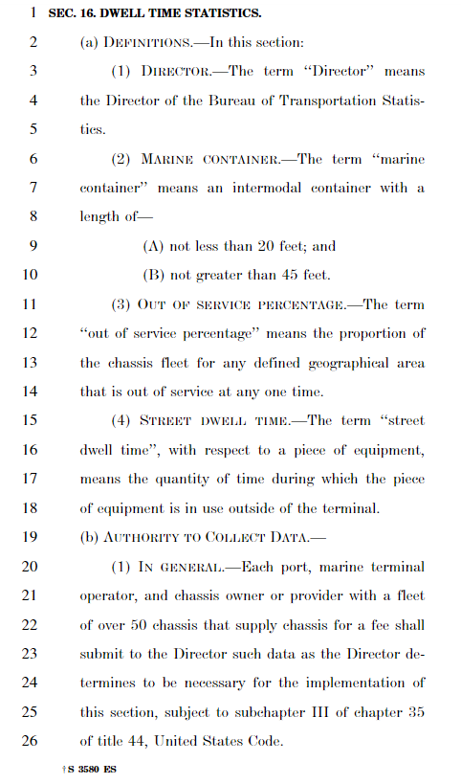
OSRA 22, Section 16
Section 16 requires who to participate?
The BTS was tasked with collecting information from each port, marine terminal operator, and chassis owner or provider with a fleet over 50 chassis that supply chassis for a fee.
Section 16 requests what information be submitted?
Total street dwell time, from all causes of marine containers and marine container chassis, and the average out of service percentage.
Section 16 how often the data be submitted?
BTS is required to publish on a monthly basis, beginning 240 days after the date of entitlement of this Act, or February 10, 2023.
Notes:
Encourage reviewing the bill which you can find on our OSRA webpage or by googling OSRA. Page 22.
Highlights….

Slide 7
Data Request
Street Dwell Time
Out of Service Rate
Field Name | Data Type | Data Format | Description | Example
ChassisID | Alpha numeric |  | Unique number ID for all chassis | TAJJ167333
Size | Integer |  | Chassis length | 20, 40, 45, etc.
Outgate_Date | Date / Time | MM/DD/YYYY HH:MM | EDI date and time stamp at time of exit during the data month | 8/5/2022 17:08
Outgate_Location | Text |  | The street address of the out-gate location | 123 Port Street, City, State, Zip
Ingate_Date | Date / Time | MM/DD/YYYY HH:MM | EDI date and time stamp at time of re-entry during the data month | 8/23/2022 19:35
Ingate_Location | Text |  | The street address of the in-gate location | 123 Port Street, City, State, Zip
Market | Text |  | The market name | Savannah
Field Name | Data Type | Description | Example
Market | Text | The market name | Savannah
Size | Integer | Chassis length | 20, 40, 45
Location | Text | The street address of the location | 123 Port Street, City, State, ZIP
OOS Chassis | Integer | The total count of OOS chassis within the data month | 200
Total Chassis | Integer | The total count of all chassis assets originating at the location within the data month (on-site and on-street) | 5,000

Slide 8
How do I submit my information?
Format
Spreadsheet, e.g., Excel
Secure Data Portal
BTS has set up a secure data portal only for the purposes of collecting OSRA data. The portal is available to only those that companies that we reach out to, and specifically to only those individuals that each company identifies as the point of contact(s) for data submissions.
Portal Access
Once a point of contact(s) has been identified to BTS, then BTS will provide the portal link and instructions on how to set up the company’s secure account access. After that submissions can be made.

Slide 9
How do I submit my information?
Submission Timeframe
Data providers will be notified monthly to submit prior month data. Submissions should made between the 10th - 15th of every month. Data publication will occur on the 10th of the following month.
Ex:
January Data Request | Month | Day | Year
Submission | January | 10 - 15 | 2023
Requested information | December | 1-31 | 2022
Publication | February | 10 | 2023

Slide 10
OSRA 22 Compliance and Data Uses
Why should I comply with the mandate? What is in it for me?
Section 16 of the bill directs the collection of street dwell time and out of service percentage data to produce statistics to be used to improve chassis and ocean shipping container management
OSRA seeks to increase transparency within the industry to help improve productivity and avoid future crises
OSRA will provide data to drive decisions within your organization
Market trends
Industry wide performance metrics
Data points for customer insights

Slide 11
In Short
BTS has been tasked to collect chassis and marine container data in compliance with Section 16 of the OSRA 22.
BTS will only publish statistics that will neither reveal information about respondents nor their individual operations.
The raw data is collected for statistical purposes only and immune from court subpoena and Freedom of Information Act (FOIA) requests.
Only BTS staff with a need to know will have access to the raw data, which otherwise will not be shared outside of BTS.
Data providers will only have access to up upload data for submissions into the secure data portal and will not have any access to viewing data within the portal.

Slide 12
How do we work with the data received?

Slide 13
Review data file and notes
Chassis# | Size | Outgate_Date | Ingate_Date | Outgate_Location | Ingate_Location | Notes
1556671874 | 40 | 12/12/24 11:19 | 12/17/24 9:25 | SEAGIRT TERM-BALTIMORE | SEAGIRT TERM-BALTIMORE
9829430608 | 20 | 12/16/24 11:28 | 12/16/24 13:29 | NS-RICKENBACKER (COLUMBUS) | NS-RICKENBACKER (COLUMBUS) | Unsure of return timestamp
4530719866 | 40 | 12/18/24 11:34 | 12/18/24 15:27 | APMT- ELIZABETH | PNCT TERMINAL-NEWARK PORT
2378025798 |  | 10/10/24 19:04 | 12/19/24 19:16 | BNSF-ST PAUL INTERMODAL RAMP | BNSF-ST PAUL INTERMODAL RAMP
9556563029 | 20 | 12/15/24 9:32 | 12/16/24 11:05 | BNSF - LOGISTICS PARK (KANSAS CITY) | ARROWHEAD INTERMODAL-EDGERTON
9884055339 | 40 | 12/27/24 14:33 | 12/29/24 10:57 | UP-GLOBAL 4 | UP-GLOBAL 4
5953491134 | 40 | 12/28/24 9:56 | 12/29/24 11:13 | BNSF - LOGISTICS PARK (KANSAS CITY) | BNSF - LOGISTICS PARK (KANSAS CITY)
9360098180 | 40 | 12/20/24 22:43 | 12/25/24 9:52 | BNSF-MEMPHIS | BNSF-MEMPHIS
7329445903 | 40 | 11/23/24 13:54 | 12/17/24 3:58 |  | GREENWICH PACKER TERMINAL
2029969986 | 40 | 11/26/24 13:22 | 12/30/24 13:27 | BARBOURS CUT CONTAINER TERMINAL | IMS-LAPORTE (INTEGRATED MARINE SVCS)
6447086615 | 20 | 12/10/24 21:14 | 12/27/24 0:23 | UNIVERSAL INTERMODAL-DALLAS | UNIVERSAL INTERMODAL-DALLAS
5453922995 | 40 | 12/15/24 10:01 | 12/28/24 12:06 | LONG BEACH TTI | APMT- LOS ANGELES | Out beyond contract
4530719866 | 40 | 12/18/24 11:34 | 12/18/24 15:27 | APMT- ELIZABETH | PNCT TERMINAL-NEWARK PORT
Missing value
If values are missing:
Follow-up with data provider, especially for large amounts of missing data
Check if missing values can be imputed using similar entries
Use what we can of the incomplete data
Review and react (follow-up/data edits)

Slide 14
Check for naming and data field consistency
Chassis# | Size | Outgate_TS | Ingate_TS | Outgate_Location | Ingate_Location
1556671874 | 40 | 12/12/24 11:19 | 12/17/24 9:25 | SEAGIRT TERM-BALTIMORE | SEAGIRT TERM-BALTIMORE
9829430608 | 40 | 12/16/24 11:28 | 12/16/24 13:29 | NS-RICKENBACKER (COLUMBUS) | CPG DEPOT-CREEKWAY (COLUMBUS)
4530719866 | 40 | 12/18/24 11:34 | 12/18/24 15:27 | APMT- ELIZABETH | PNCT TERMINAL-NEWARK PORT
Provider 1
ChassisID | Size_Class | Outgate_Date | Ingate_Date | Outgate_Loc | Ingate_Loc
5953491134 | 40 | 12/28/24 9:56 | 12/29/24 11:13 | BNSF - LOGISTICS PARK (KANSAS CITY) | ARROWHEAD INTERMODAL-EDGERTON
9360098180 | 40 | 12/20/24 22:43 | 12/25/24 9:52 | BNSF-MEMPHIS | IMC DEPOT-MEMPHIS
7329445903 | 40 | 11/23/24 13:54 | 12/17/24 3:58 | CSX-PHILADELPHIA | GREENWICH PACKER TERMINAL
Provider 2
Make headers and data type match
Chassis# | Size | Outgate_Date | Ingate_Date | Outgate_Loc | Ingate_Loc
1556671874 | 40 | 12/12/24 11:19 | 12/17/24 9:25 | SEAGIRT TERM-BALTIMORE | SEAGIRT TERM-BALTIMORE
9829430608 | 40 | 12/16/24 11:28 | 12/16/24 13:29 | NS-RICKENBACKER (COLUMBUS) | CPG DEPOT-CREEKWAY (COLUMBUS)
4530719866 | 40 | 12/18/24 11:34 | 12/18/24 15:27 | APMT- ELIZABETH | PNCT TERMINAL-NEWARK PORT
Chassis# | Size | Outgate_Date | Ingate_Date | Outgate_Loc | Ingate_Loc
5953491134 | 40 | 12/28/24 9:56 | 12/29/24 11:13 | BNSF - LOGISTICS PARK (KANSAS CITY) | ARROWHEAD INTERMODAL-EDGERTON
9360098180 | 40 | 12/20/24 22:43 | 12/25/24 9:52 | BNSF-MEMPHIS | IMC DEPOT-MEMPHIS
7329445903 | 40 | 11/23/24 13:54 | 12/17/24 3:58 | CSX-PHILADELPHIA | GREENWICH PACKER TERMINAL

Slide 15
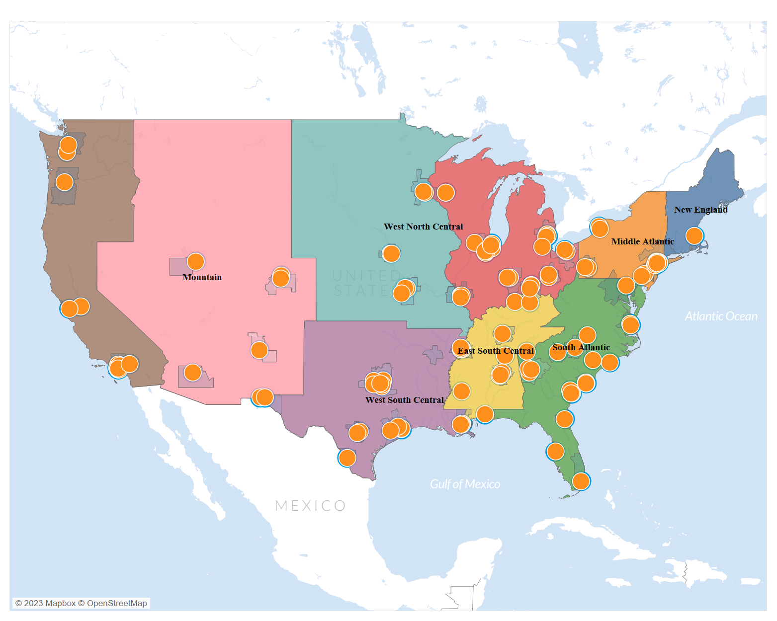
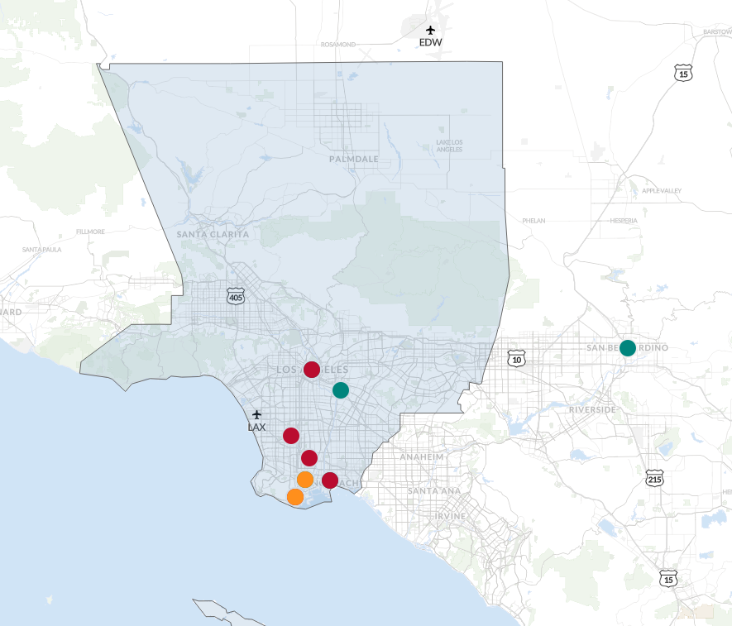
Identify geography
The addresses provided will be aggregated to a market to create a consistent market definition across all providers that will serve as the local level. Then they will be further aggregated to a regional and national level.
Included in regional estimate, not local

Slide 16
Combine data
Now that the prior steps have been accomplished the data can be combined across all data files received. This results in one master file of all providers' data together on which calculations are made.
Provider 1
Chassis# | Size | Outgate_Date | Ingate_Date | Outgate_Loc | Ingate_Loc
1556671874 | 40 | 12/12/24 11:19 | 12/17/24 9:25 | Baltimore | Baltimore
9829430608 | 40 | 12/16/24 11:28 | 12/16/24 13:29 | Columbus | Columbus
4530719866 | 40 | 12/18/24 11:34 | 12/18/24 15:27 | New Jersey | New Jersey
Chassis# | Size | Outgate_Date | Ingate_Date | Outgate_Loc | Ingate_Loc
1556671874 | 40 | 12/12/24 11:19 | 12/17/24 9:25 | Baltimore | Baltimore
9829430608 | 40 | 12/16/24 11:28 | 12/16/24 13:29 | Columbus | Columbus
4530719866 | 40 | 12/18/24 11:34 | 12/18/24 15:27 | New Jersey | New Jersey
5953491134 | 40 | 12/28/24 9:56 | 12/29/24 11:13 | MidWest | MidWest
9360098180 | 40 | 12/20/24 22:43 | 12/25/24 9:52 | Memphis | Memphis
7329445903 | 40 | 11/23/24 13:54 | 12/17/24 3:58 | NorthEast | NorthEast
Provider 2
Chassis# | Size | Outgate_Date | Ingate_Date | Outgate_Loc | Ingate_Loc
5953491134 | 40 | 12/28/24 9:56 | 12/29/24 11:13 | MidWest | MidWest
9360098180 | 40 | 12/20/24 22:43 | 12/25/24 9:52 | Memphis | Memphis
7329445903 | 40 | 11/23/24 13:54 | 12/17/24 3:58 | NorthEast | NorthEast

Slide 17
Data Cleansing
Duplicate Data Entries Example
Provider 1
Provider 1
Chassis# | Size | Outgate Time | Ingate Time
6447086615 | 40 | 12/10/24 21:14 | 12/27/24 0:23
5453922995 | 40 | 12/15/24 10:01 | 12/28/24 12:06
4530719866 | 40 | 12/18/24 11:34 | 12/18/24 15:27
Chassis# | Size | Outgate Time | Ingate Time
6447086615 | 40 | 12/18/24 11:34 | 12/18/24 15:27
5453922995 | 40 | 12/15/24 10:01 | 12/28/24 12:06
4530719866 | 40 | 12/10/24 21:14 | 12/27/24 0:23
Provider 2
Provider 2
Chassis# | Size | Outgate Time | Ingate Time
1556671874 | 40 | 12/12/24 11:19 | 12/17/24 9:25
9829430608 | 40 | 12/16/24 11:28 | 12/16/24 13:29
4530719866 | 40 | 12/18/24 11:34 | 12/18/24 15:27
Chassis# | Size | Outgate Time | Ingate Time
1556671874 | 40 | 12/12/24 11:19 | 12/17/24 9:25
9829430608 | 40 | 12/16/24 11:28 | 12/16/24 13:29
4530719866 | 40 | 12/15/24 15:14 | 12/18/24 8:31
Scrub one entry
Further research

Slide 18
How do we calculate Street Dwell Time and the Out of Service Rates?

Slide 19
Calculating Street Dwell Time
Chassis# | Size | Outgate_Date | Ingate_Date | Outgate_Location | Ingate_Location | Dwell
1556671874 | 40 | 12/12/24 11:19 | 12/17/24 9:25 | SEAGIRT TERM-BALTIMORE | SEAGIRT TERM-BALTIMORE | 4.92
9829430608 | 40 | 12/16/24 11:28 | 12/16/24 13:29 | NS-RICKENBACKER (COLUMBUS) | NS-RICKENBACKER (COLUMBUS) | 0.08s
4530719866 | 40 | 12/18/24 11:34 | 12/18/24 15:27 | APMT- ELIZABETH | APMT- ELIZABETH | 0.16
2378025798 | 40 | 10/10/24 19:04 | 12/19/24 19:16 | BNSF-ST PAUL INTERMODAL RAMP | BNSF-ST PAUL INTERMODAL RAMP | 70.00
 |  |  |  |  | Mean | 18.79
Street Dwell Time (days) = Ingate_Date - Outgate_Date
As a result, the average reported street dwell time for these 40-foot chassis is 18.79 days.

Slide 20
Calculating Out of Service Rates
In this example, the 4 data providers submitted 1) their total count of Out of Service (OOS) chassis by Geography A, and 2) their total number of chassis by Geography A. With this information we calculated the total Out of Service percentage for Geography A: OOS Count / Inventory Count = OOS Rate
Provider | OOS Count within Geography A | Inventory Count within Geography A | Calculated OOS %
1 | 5 | 100
2 | 15 | 60
3 | 25 | 50
4 | 20 | 200
Total | 65 | 410 | 15.85%
With this information we can now calculate the correct out of service percentage across all data providers using the following math:
Total OOS Count = 65
Total Inventory Count = 410
Total OOS Rate = 65 / 410 = 15.85%

Slide 21
Calculating Out of Service Percentage Rates
In this example, we present the need for each provider to submit more than just their total out of service percentage by location.
Provider | Provided Percentage
1 | 5%
2 | 25%
3 | 50%
4 | 10%
If we only have the total OOS percentage by data provider, then for the industry, we will erroneously calculate the following average:
Out of Service Rate = (5% + 25% + 50% +10%)/4
Out of Service Rate = 22.5%

Slide 22
Final Product Mock-Up
Monthly data will be aggregated and tabulated at a local, regional, and national level. Data at the local or regional level will be suppressed if BTS sees any disclosure concerns.
Local-level* Statistics for 40 Foot Chassis
Regional and National-level Statistics
for 40 Foot Chassis
 | 40 Foot Chassis
 | Mean Dwell Time (Days) | Average Out of Service Percent (%)
Los Angeles/Long Beach | 2.3 | 1.5
Chicago | 47.5 | 5.6
Baltimore | 4.4 | 0.7
Savannah | 53.8 | 3.8
Atlanta | 18.1 | 5.8
Houston | 15.1 | 2.2
Oakland | 35.5 | 1.3
Memphis | 61.7 | 5.5
Jacksonville | 46.8 | 6.2
Etc….
 | 40 Foot Chassis
 | Mean Dwell Time (Days) | Average Out of Service Percent (%)
West | 23.6 | 5.3
Midwest | 15.3 | 4.7
South | 37.4 | 6.5
Northeast | 18.9 | 5.6
National | 28.3 | 4.9
Notes:
For illustrative purposes

Slide 23
Data Security and Confidentiality

Slide 24
Large image
13 Principal Federal Statistical Agencies
Guided by OMB Statistical Policy Directives to assure objectivity and credibility of agency products
Essential for private and public decision making
Agencies collaborate on:
Confidentiality
Data Quality
Statistical Issues

Slide 25
CIPSEA
Principles of The Confidential Information Protection and Statistical Efficiency Act (CIPESA)
CIPSEA provides a uniform and standardized pledge of confidentiality to individuals and businesses, which is different than other privacy laws
Protects information reported to the government above and beyond the identity of the reporter (beyond PII)
The CIPSEA mandate is to allow for release of information on emerging trends and patterns describing characteristics of groups, without identifying those individuals or organizations
Assures information reported will be kept confidential and only be used for statistical purposes
The only exception is explicit consent of the reporting entity: the data provider grants permission for information to be released in an identifiable form or used for some other purpose

Slide 26
CIPSEA
Statistical Purpose
Description, estimation, or analysis of the characteristics of groups, without identifying those individuals or organizations
Includes all aspects of data
Protecting the data portal and server that the data is reported into
Maintaining administrative procedures dictating who has access to data (need to know only)
Making sure that any data releases only include information that has been sufficiently aggregated to protect the identity of those who provided the original information

Slide 27
CIPSEA
Legal
BTS has the power to invoke CIPSEA for data collections (including OSRA 22) where appropriate
Data collected under CIPSEA is:
Immune from legal process (court subpoena) and cannot be admitted as evidence
Exempt from Freedom of Information Act (FOIA) requests
Any federal employee, contractor, or agent accessing CIPSEA data on BTS’s behalf who willfully discloses confidential information (under CIPSEA) faces:
Removal from office, and/or
Class-E felony conviction (fines up to $250,000 and/or imprisonment of up to 5 years)

Slide 28
BTS Private Network
BTS Private Network
Separate servers, residing within the private network
No sharing of files between DOT main network and BTS private network.
No direct access to internet
Analysis software to allow data analysis within the private network
Backups maintained within the private network
DOT Main Network
Access email, internet, all DOT software
Connected to DOT main servers to share files with colleagues
Backed up servers by DOT protocols

Slide 29
Disclosure Review
Disclosure Review Process Update
BTS staff and the BTS Confidentiality Officer work jointly to determine specific conditions for a data release
Reports
Datasets
Metadata
Process ensures that any data releases include only information that has been sufficiently aggregated
Protects the identity of the reporting entity
Protects the details of what was reported by the reporting entity
Geographic aggregation will be one strategy to protect data

Slide 30
Questions?

Slide 31
Contact Us
OSRA@dot.gov
Office of Data Development and Standards (ODDS)
Cha-Chi Fan, Ph.D., Office Director, chachi.fan@dot.gov, 202-366-0483
April Gadsby, Ph.D., Mathematical Statistician, april.Gadsby@dot.gov
Janine McFadden, Senior Survey Statistician, Project Manager, janine.mcfadden@dot.gov, 202-366-2468
Clara Reschovsky, Senior Survey Statistician, Confidentiality Officer, clara.Reschovsky@dot.gov, 202-366-2857
Office of Transportation Analysis (OTA)
Matthew Chambers, Senior Transportation Analyst, matthew.chambers@dot.gov, 202-809-4785
April Taylor, Senior Freight Specialist (on detail from the United States Department of Agriculture), april.taylor@dot.gov

Slide 32
Stay Connected
If you would like to receive updates about OSRA, including, future webinars, announcements, and more, please email us your contact information to OSRA@dot.gov
Also, please visit us at: Ocean Shipping Reform Act of 2022 (OSRA 22) | Bureau of Transportation Statistics (bts.gov) where you can find a recording and transcript of today’s presentation.
Thank you!

