Slide 1

Advisory Council on Transportation Statistics
Thursday, September 10, 2015
Briefing on Aviation Data Programs
Bureau of Transportation Statistics
US Department of Transportation
Bill Chadwick, Director
Office of Airline Information (OAI)

Slide 2
Agenda
  Uses and value of OAI data
  Current improvements to OAI data processing efficiency and data quality
  Ongoing challenges
  Feedback on future directions

Slide 3
  OAI Data Programs
Air Traffic:
Passengers (enplaned), Freight/Mail, Capacity, Operational Statistics
Origin and Destination:
Ticket Information, Average Fare, Itinerary Cost, Market & Segment
Passenger Analysis
Airline Financials:
Balance Sheet, Income Statement, Operating Expenses,
Employment/Fuel Cost & Use
Airline Performance:
On-time arrivals, Tarmac Delays, Causes of Delay, Mishandled Baggage,
Baggage Fees

Slide 4
Congress
FAA
State
Dept.
DOT
DOJ
DHS
Dept. of Energy
Industry
Commerce
Dept.
OAI
NTSB
Public/
Academia
Council Econ. Advisors
GAO
ICAO
DOT IG
Aviation Policy & Program
Airports
DOT Counsel

Slide 5
Uses of OAI Data
  Worldwide, OAI is the most comprehensive source of airline-related statistics
  Analysis of airline competition, allowing informed decision-making
  Consumer protection and information, including the Air Travel Consumer Report
  Objectively portray state of aviation industry and airline performance; e.g., profitability and service demand
  Negotiation of international air service agreements and International Air Transport (IATA) agreements
  Determination of eligibility into Essential Air Service (EAS) Subsidy Program

Slide 6
Air Traffic Data
  Who Must Report to OAI:
  All U.S. Certificated Air Carriers, U.S. Commuter Air Carriers and Foreign Air Carriers Operating to the United States must report Airline Traffic information (approx. 125)
Type of Airline Traffic Information reported:
  Non-Step Segment – includes every revenue departure between two points and what is carried between two points on that aircraft, for each departure, including number of passengers, freight and mail (includes diversions, flag stops, tech-stops, emergency landings)
  On-Flight Market – passengers, freight, and mail enplaned between two points regardless of the number of stops between the points
When is the Data Reported:
  Airline Traffic information is to be submitted 30 days following the end of the previous month
Other OAI Processes that require Airline Traffic Information:
  Origin and Destination (OND) Survey for route verification

Slide 7
Specific Uses of Air Traffic Data
T100 Segment and Market data are used by the department to determine Mail rates; Fuel subsidies; Fitness; and the over all health of the industry. The data are available for download to the general public.
FAA uses the T100 market data to compare with the commercial airports to determine airport improvement funds, to determine air traffic operational needs and to develop regulations.
OAI collects traffic data from air taxis that are awarded EAS, Essential Air Service contracts to monitor frequencies.
USPS uses the T100 Segment to monitor frequencies for the intra-Alaskan air carriers and the T100 market data to determine mail tender.

Slide 8
Air Traffic Quality Assurance Process
T100 QA Process Involves:
  Comparison of Output Reports:
    To validate against OAG Scheduled Flight Data
    To identify errors reported by the carriers such as incorrect date/entity
    To validate the segment/market analysis
    If necessary, contact the Airline
  Contacting Airline Revenue Accounting Associate:
    For Submission if delinquent
    For Re-Submission if data errors occurred, such as formatting, invalid airport codes, etc.
The T100 System structure is automated with ~ 30 edit checks but Data Analyst manual review is still required (i.e. updates of Support Tables after validating of data from airline)

Slide 9
Air Traffic Data Challenges
Mergers
  New Operations and Revenue Accounting Department for combined airline
  Can cause data discrepancies between Air Traffic (T100), O&D, Form 41, and 298c data resulting in carrier contact and possible resubmission of reports
  Consistent turn-over within the airlines keep OAI in the constant training mode.
  Airline personal may not understand the airline’s operations or passenger processing systems and often do not communicate within their departments or with OAI.

Slide 10
Origin and Destination Survey Data
  Who Must Report to OAI:
  All U.S. Certificated Air Carriers that operate aircraft greater than 50 Seats and/or fly between U.S. and foreign countries
  Air Carriers that wish to participate in immunity agreements to share pricing and scheduling information
What Information Must Be Reported:
  A Random 10% Sampling of a Passenger’s Itinerary which includes:
    Origin, Destination, and all Intermediate Points
    Price passenger paid for the ticket (excluding baggage fees, change fees, etc.)
    The Airline in which:
      Marketed the Ticket to the passenger
      Sold the Ticket to the passenger
      Actually carried the passenger to their destination
When is the Information to be Reported:
  Airline OND information is to be submitted 45 days following the end of quarter
Why is the Airline OND Information Reported (in addition to CFRs)?
  To determine:
    “Where are people going?”
    “How much are they paying to get there?”
    “Is the local market competitive?”

Slide 11
Specific Uses of O&D Data
Cincinnati (CVG) International Airport utilizes the Quarterly Average Fare Press Release to evaluate competition at their airport
  Delta Airlines uses CVG as a Hub airport and is responsible for about 90% of the traffic
    As a result, higher fares can be charged since there is limited competition
    For the past three years, CVG has the highest fare (or in the top 3 airports)
  CVG Airport Officials reviews the press release to seek new entrants to the airport to help lower the average fare
    In 2014, CVG obtained a commitment by Frontier Airlines to start operations at the airport (Frontier started in October 2014)
    Result: Fares at CVG have been decreasing.
FAA performs analysis on the Origin and Destination Survey to allocate airport improvement grant funds, to determine air traffic operational needs and to develop regulations
  This data are being used in the implementation of the Satellite Based Navigational System Project

Slide 12
O&D Data Quality Assurance Process
O&D QA Process Involves:
  Comparison of Output Reports:
    To validate against OAG Scheduled Flight Data
    To identify market count discrepancies between T100 and OND submissions
    If necessary, contact the Airline Revenue Associate
  Contacting Airline Revenue Accounting Associate:
    For Submission if delinquent
    For Re-Submission if data errors occurred, such as formatting, invalid airport codes, etc.
OAI’s O&D System structure is as automated as much as possible, Data Analyst manual review is still required (i.e., updates of Support Tables after validating of data from airline)

Slide 13
O&D Data Challenges
Mergers
  New Operations and Revenue Accounting Department for combined airline can cause data discrepancies between Traffic(T100) and OND.
  Results in inability to balance market data reported.
  Use of Code-Shares can cause discrepancies in reported data; e.g., Airline X uses YY partner, whereas Airline Y uses ZZ partner.
  Airline X writes the ticket with Airline Y’s partner but does not notify OAG or OAI of such.
  Airline Revenue Accounting Associates
  May not yet be familiar with other airline’s operations or passenger processing systems
  May not have contact with the Operations Center that submitted T100

Slide 14
Airline Financial Data
  Who Must Report to OAI:
  Data are reported by Large Certificated Carriers. 69 U.S. Carriers report Form 41 Financial data:
  15 major carriers, 30 national carriers, 15 large regionals, 9 medium regionals.
  Form 41 Financials data validation includes:
  Hard coded business rules
  Checks against reported T100 Segment data: aircraft types and configurations
  Checks against reported T100 Segment Block Hours Carriers are notified by email when reports are flagged for errors
  OAI Data Administrators review errors and warnings and advise carriers of the need to explain or revise
  Data are released to a Sybase data warehouse for internal use by DOT customers and to the Public via the TranStats website.
  The data are used for BTS Press Releases:
    Monthly Fuel Cost/Consumption
    Monthly Employee Headcount
    Quarterly Airlines Profitability Report

Slide 15
Specific Uses of Airline Financial Data
Dept of Commerce – Bureau of Economic Analysis
  Airline economic data is included in BEA’s published GDP – Gross Domestic Product
Dept of Energy
  Uses airline fuel data in monitoring industry fuel consumption for emergency preparedness
Dept of Labor – Bureau of Labor Statistics
  Uses airline employment data for productivity studies
Dept of Transportation – Federal Aviation Administration
  Monitors changes in the air carrier’s financial well being as one aspect in making decisions as to increased safety surveillance
International Civil Aviation Organization
  Airline economic data is sent to ICAO under 1947 international treaty. Used for all major international negotiations and agreements
Federal Elections Committee
  Monitors election committees’ indebtedness to airlines for providing air transportation to candidates

Slide 16
Airline Financial Data Quality Assurance Process
Financial QA Process Involves:
  Comparison of data to previously reported period and same period in the previous year:
    There are 20 validations or cross checks conducted within the data to verify its accuracy for current period
    Reasonableness checks are conducted to verify accuracy
  Contacting accounting dept or CFO/Comptroller:
    For Submission if delinquent
    For Re-Submission if data errors occurred based on the above QA process
OAI’s Financial System structure could be automated more, depending on time, personnel and funds. Data Analyst manual review is still required (i.e. to determine why data is incorrect and explain to the airline what steps need to be taken to correct)

Slide 17
Airline Financial Data Challenges
Mergers
  New Operations and Accounting Department for combined airline can cause data discrepancies between Traffic(T100) and financials.
  Results in inability to balance/validate aircraft financial data against aircraft traffic data from T100.
  Getting the airlines to fully understand DOT accounting and its Chart of Accounts. Airlines are used to GAAP (Generally Accepted Accounting Procedures) and have a hard time flipping to DOT reporting. This accounts for a majority of errors and understanding.
  Fully automating the entire financials dataset. Time, personnel and funds are a substantial setback.

Slide 18
Airline Performance Data
  OAI compiles Airline Performance data on:
  On-time performance
  Lost Baggage
  Baggage Fees Assessed
For purposes of:
  Overall airline and airport on-time performance
  Identifying long tarmac times for consumer protection purposes
  Taxi times by airport
  Identifying gate returns, flight returns, and diverted landings
  Identifying a generic cause of delay or cancellation
On-Time Performance is defined as flights arriving or departing the gate less than 15 minutes after the scheduled time.
  15 U.S. air carriers that have at least 1 percent of total domestic scheduled-service passenger revenues must report
  Challenges
  How much performance data can be captured automatically from the air traffic control system and airport ground traffic management systems?

Slide 19
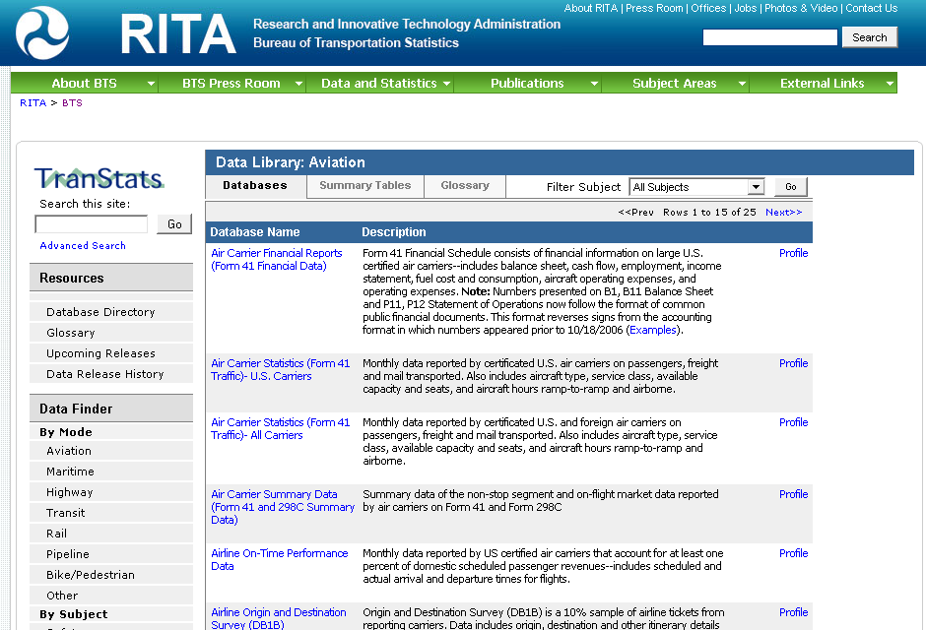
  http://www.bts.gov for Scheduled Product Releases Available as Datasets
http://www.transtats.bts.gov for Airline Traffic/Financial/On-Time Performance/Origin & Destination of Air Passengers

Slide 20
Future Directions
Improved technology for capturing and processing data?
Different approaches to making data available?
Increased use of statistical analysis for quality assurance?

