Slide 1
Advisory Council on Transportation Statistics
Transportation Economic Measures
May 19, 2015
Karen White

Slide 2
Overview
Transportation Services Index
Overview
Recent Research Activity
Transportation Satellite Accounts
Overview
Recent Research Activity
Economic Analysis Outreach

Slide 3
Transportation Services Index (TSI) Overview
A monthly measure of the volume of services performed by the ‘for-hire’ transportation sector (for hire transportation services are produced by transportation companies, and sold to other firms and to households)
For hire transportation includes trucking, freight rail, passenger rail, and aviation
TSI consists of three data series –
Freight TSI which covers the activities of for-hire freight carriers
Passenger TSI which covers the activities of for-hire passenger carriers
Combined TSI which includes all for hire transportation services

Slide 4
TSI Production Process
Data
Seasonal
Adjustment
Index
2000
Weight
& Combine
Weight
& Combine
Chain
Air Revenue
Passenger- Miles
Passenger
TSI
Chained
Passenger
TSI
Transit
Ridership
Rail Revenue
Passenger-Miles
TSI
Truck
Tonnage
Freight
TSI
Chained
TSI
Rail Carloads
& Intermodals
Waterborne
Commerce
Chained
Freight
TSI
Air
Ton-Miles
Movement of
Gas & Petroleum

Slide 5
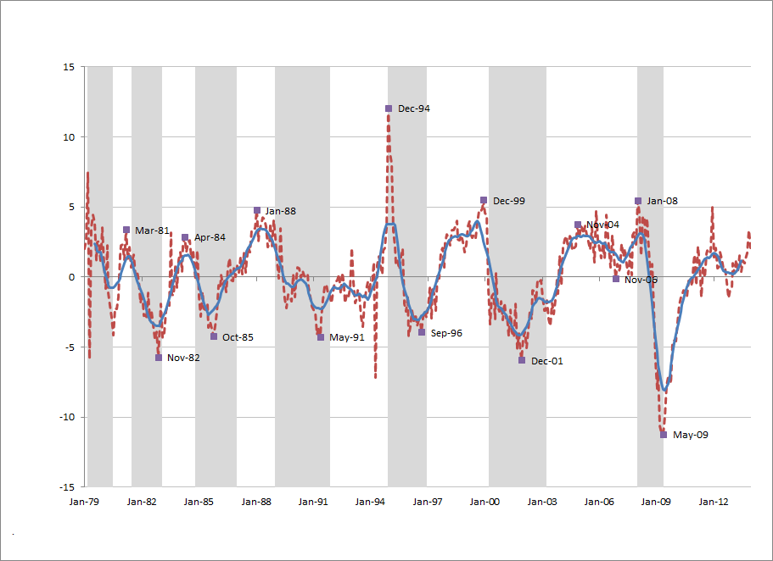
TSI Freight compared to Growth Cycles
Notes:
TSI freight leads the growth cycles by an average of 4 – 5 months

Slide 6
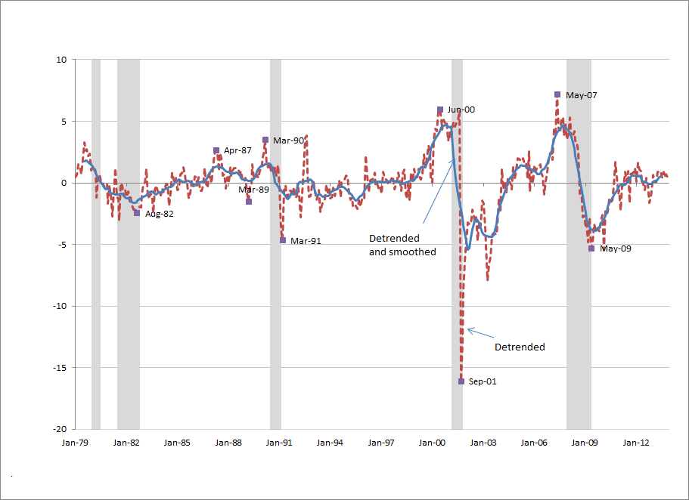
TSI Passenger Compared to Business Cycles
Notes:
TSI passenger leads recessionary periods by an average of 4 – 5 months

Slide 7
Seasonally Adjusted Transportation Data
http://www.transtats.bts.gov/osea/seasonaladjustment/?PageVar=VMT
Air – available seat miles, enplanements, load factor, revenue passenger miles, revenue ton-miles
Rail – freight carloads, intermodal traffic, passenger miles,
Transit ridership
Pipeline movements, natural gas consumption
Waterway tons

Slide 8
Transportation Satellite Account
For-Hire: BEA’s I-O accounts show the transportation value added by air, rail, water, truck, transit and ground passenger transportation, pipeline, other transportation and support activities, and warehousing and storage.
In-House: TSAs add on to I-O accounts. Show value of air, rail, water, and truck transportation produced and used within non-transportation industries.
In-House Household Transportation – New addition to TSA.
Annual 2002 - 2012

Slide 9
Value Added by Transportation
Notes:
For-hire and in-house air, rail, truck, and water transportation contributed about contributed $407 billion in 2012 to the national economy. Including other modes of for-hire transportation (such as pipeline and warehousing) and household transportation, brings the value added by transportation to $755 billion in 2012 (about 4.6% of GDP)

Slide 10
TSA Components
Structure replicates I-O accounts.
Make table:
Value of commodities produced by each industry
Use table:
Value of commodities used by each industry during production
Direct requirements table:
Value of commodities used by each industry during production as per dollar of industry output
Commodity by commodity requirements table:
Value of inputs for each commodity required to deliver a dollar of the commodity to final users
Notes:
The TSAs maintain the framework of the I-O accounts from which they are derived. So the TSAs contain the same tables as the I-O accounts. This includes a make, use, direct requirements, and total requirements table. I am going to describe the kind of information that can be acquired from the tables to measure the value of transportation.
Direct and Indirect effects also computed but not included in this presentation

Slide 11
Cost of Transportation Services by Commodity
(TSA commodity-by-commodity requirements table) 2012
Notes:
The amount of transportation required to deliver a commodity differs from the amount of transportation required to produce a dollar of industry output because, in most cases, commodities are produced by multiple industries.
The TSA commodity-by-commodity requirements table shows the amount of transportation required to deliver a dollar of a commodity to final users. The preliminary 2012 data show that 5.9 cents of transportation is required to deliver a dollar of wholesale/retail trade goods to final users. This value is different from the amount of transportation required per dollar of industry output because wholesale/retail trade goods are produced by multiple industries. The TSA make table provides the information on what industries produce each commodity.

Slide 12
Economic Analysis - Outreach
Transportation Services Index
Conference Board
Federal Reserve Bank of St. Louis – FRED
Fast Lane Blog – 10 year anniversary of TSI
Transportation Satellite Accounts
2006 – 2012 accounts ready for release
New publication – Understanding the TSA
Notes:
Conference board included TSI in its database of Global Business Cycle Indicators
Federal Reserve Bank of St. Louis accepted TSI and seasonally adjusted travel data into FRED

Slide 13
Upcoming Economic Analysis
June Visiting BEA on BTS Economic Products and BEA Productivity Accounts.
Transportation Satellite Account Abstract Submitted to American Economic Association (for SGE session)
Transportation Economic Facts and Figures

