Slide 1
Product Delivery and User Experience
Goals:
(1) more effectively disseminate our products,
(2) improve our users’ experiences in using our products, and
(3) provide simple visual analytics to our users.

Slide 2
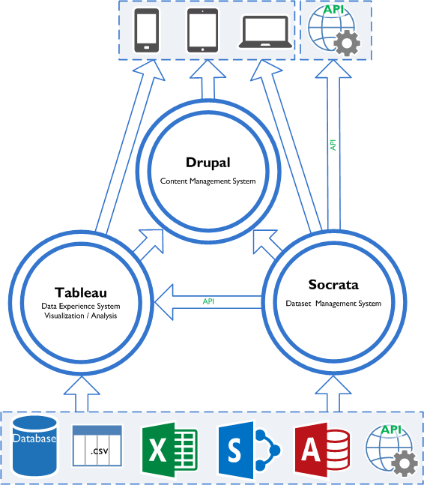
Notes:
`

Slide 3
Product Delivery and User Experience
Prototyping a replacement for the Multimodal Transportation Indicators monthly report

Slide 4
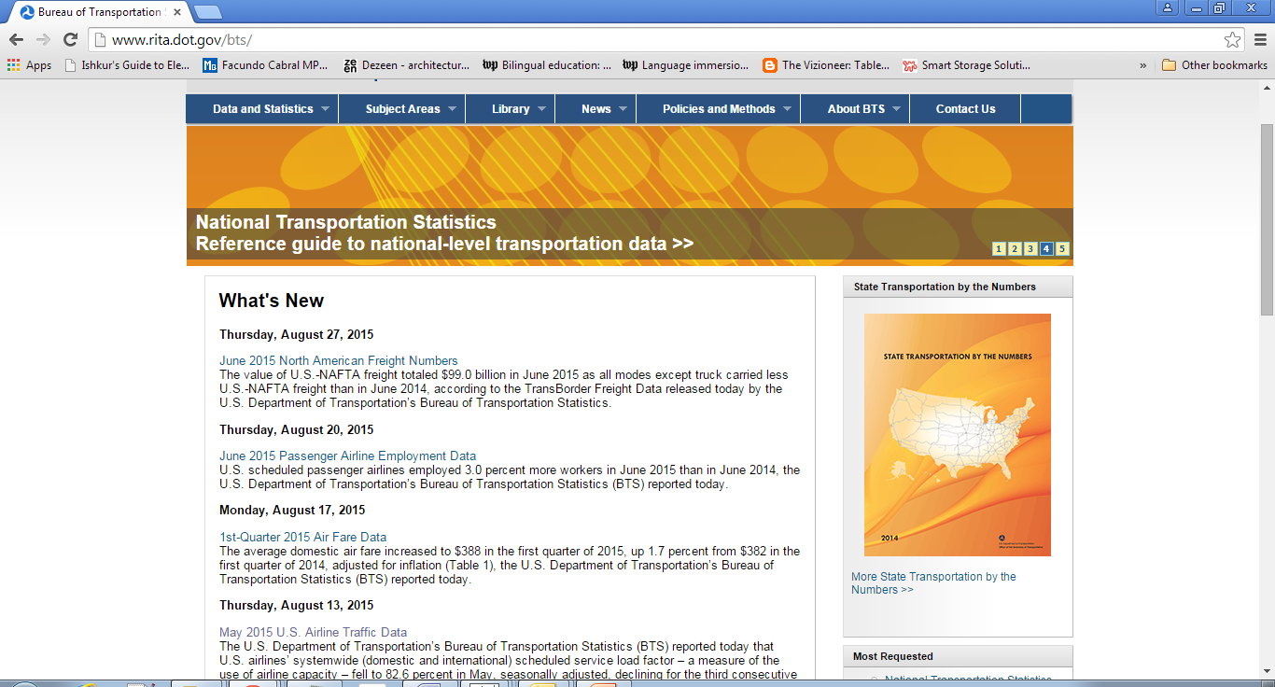

Slide 5
Imagine, inspired by this →

Slide 7
Mock-up – Zoomed in

Slide 10
Food for Thought
Tableau Dashboard Prototype Test-Drive

Slide 11
Real-time Data

Slide 12
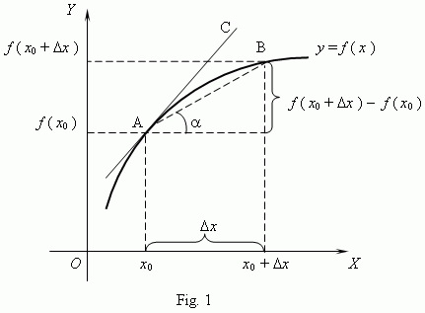
Real time*
Actual real-time – “I want data about now”
# of airplanes in the air
Descriptive statistics, discretized – “Every x seconds, y happens”
Yearly sum ÷ 365 days ÷ 24 hours ÷ 60 minutes ÷ x seconds…refresh
Fresh – “I want data faster, in ‘real time’ to make informed decisions in a timely manner”
Processing turnaround /QA time

Slide 13
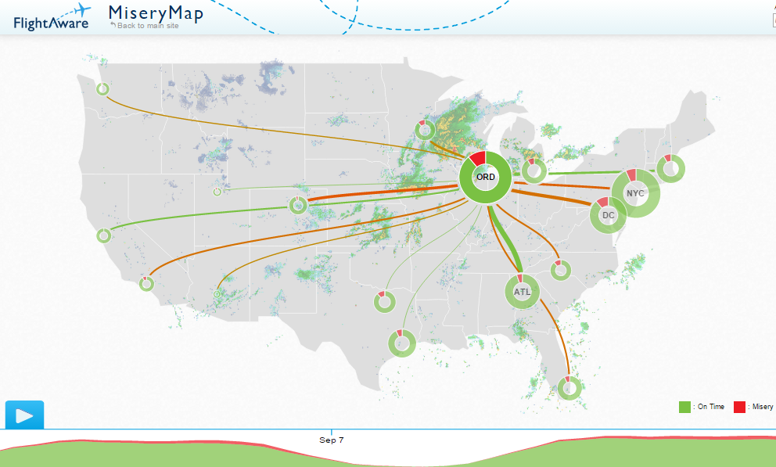
FlightAware Misery Map

Slide 14
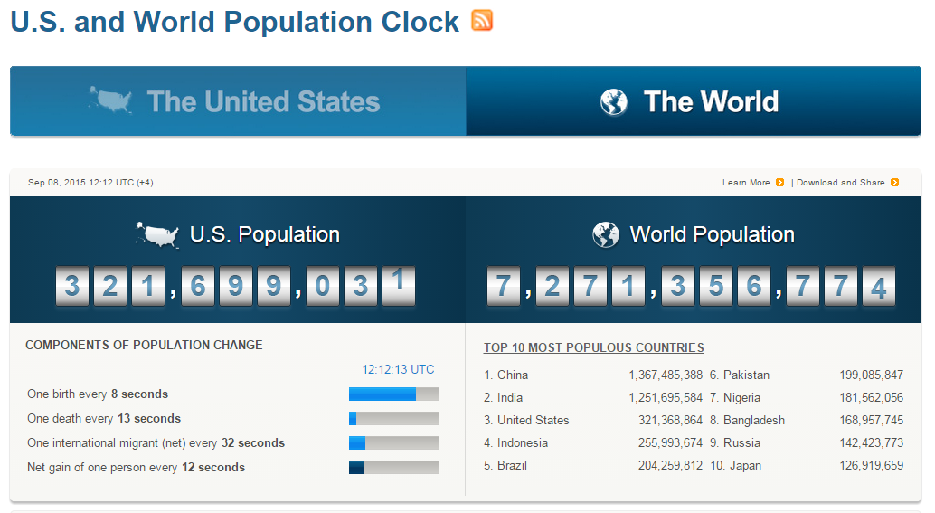
US Census Population Clock

Slide 15
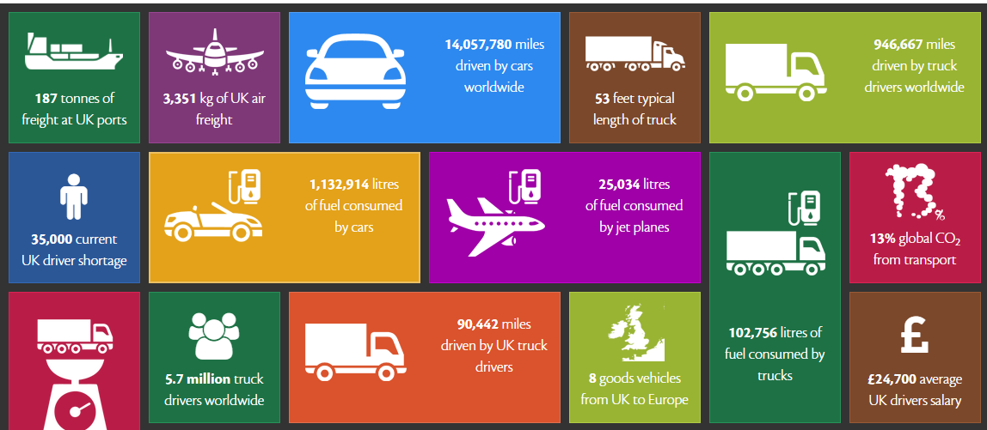
UK & Global Transport Facts

Slide 16
Discussion

