Slide 1
National Census of Ferry Operators: Past, Present, and Future Ken Steve, Bureau of Transportation Statistics Janine McFadden, Bureau of Transportation Statistics July 26, 2016

Slide 2
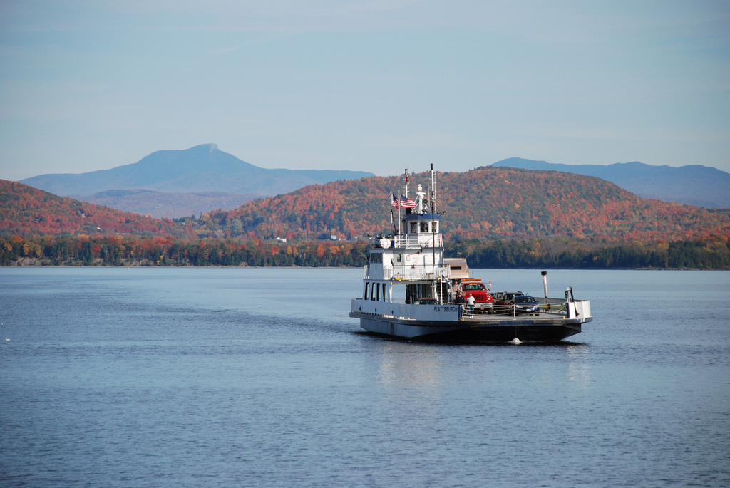
Webinar Overview
Ken Steve
History of the NCFO
NCFO Website
Results of the 2014 NCFO
Janine McFadden
2016 questionnaire development
2016 questionnaire updates
Collection efforts
Collection status summary
Looking towards the future, the 2018 NCFO

Slide 3
History of the NCFO
Legislation
June 1998: Transportation Equity Act for the 21st Century (TEA–21)
October 2009: Safe, Accountable, Flexible Efficient Transportation Equity Act—A Legacy for Users (SAFETEA-LU)
June 2012: Moving Ahead for Progress in the 21st Century Act (MAP-21)
October 2015: Fixing America’s Surface Transportation Act (FAST Act)
Project Evolution
2000: FHWA via Volpe National Transportation Center
2006 & 2008: BTS, Different Project Managers
2010 & 2014: BTS, Kenneth Steve as Project Manager
2016 Forward: BTS, Janine Mcfadden as Project Manager
Notes:
TEA–21 directed the Secretary of Transportation to conduct a study of ferry transportation in the United States and its possessions. In 2000, the FHWA Office conducted a survey of approximately 250 ferry operators to identify existing ferry operations, the locations and routes served, the source and amount, if any, of funds derived from Federal, State, or local governments supporting ferry construction or operations.
SAFETEA-LU) required that the Secretary, acting through BTS, establish and maintain (biennially) a national ferry database containing current information regarding routes, vessels, passengers and vehicles carried, funding sources and such other information as the Secretary considers useful.
MAP-21 continued the BTS mandate to conduct the NCFO and required that the FHWA use the NCFO data to set the specific formula for allocating federal ferry funds. The funding allocations are based on a percentage of the number of passenger boardings, vehicle boardings, and route miles served. This legislation also required that BTS make additional changes to the NCFO questionnaire to ensure that the resulting database was consistent with the National Transit Database maintained by the Federal Transit Administration FTA.

Slide 4
History of the NCFO (2010 Changes)
Conducted cognitive interviews
5 interviews among 4 different operators
Made more changes based on results
Reviewed the old form and corresponding data
Reformatted paper questionnaire
Modified question wording (stems and responses)
Deleted some questions and added new questions
Created a web version based on finalized paper questionnaire
Discrete user IDs
Pre-populated with 2008 data (static information)
Allowed operators to modify/add/delete information as needed

Slide 5
History of the NCFO (2014 Changes)
Expanded response options for revenue streams
Removed questions about peak ridership times and counts
Expanded vessel characteristic questions
ownership and operation
fuel mileage
ADA accessible
engine lifespan (2012 hours and miles)
Expanded terminal characteristic questions
ownership and operation
Expanded route characteristic questions
regulation
vessel most commonly used
Expanded funding source questions
agency type, name and program

Slide 6
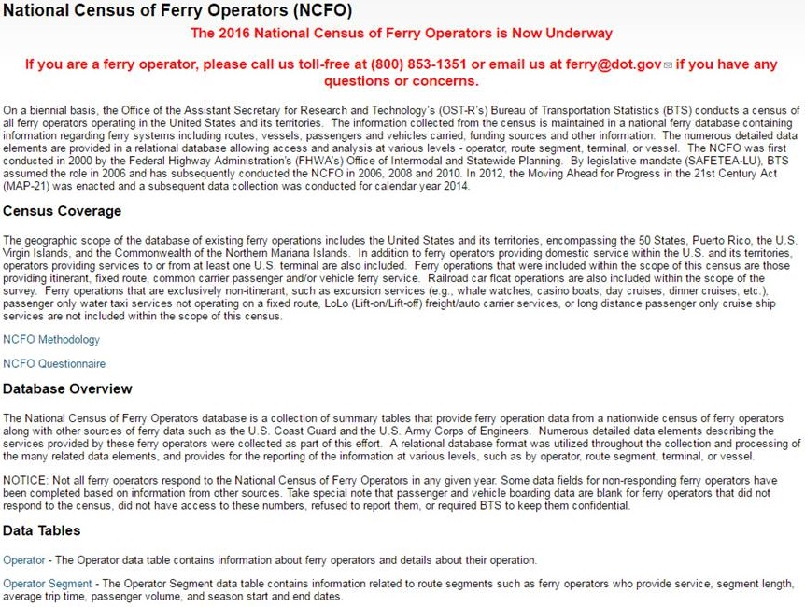
NCFO Website (Home Page)
Notes:
Developed the website in 2010 as a landing site where information on the NCFO efforts could be accessed by the public.
Provide resources to stakeholders and increase transparency with NCFO methodology.
Contains background info, census coverage, a detailed description of the methodology, an overview of the database and links to data tables, and summary reports for each census year.

Slide 7
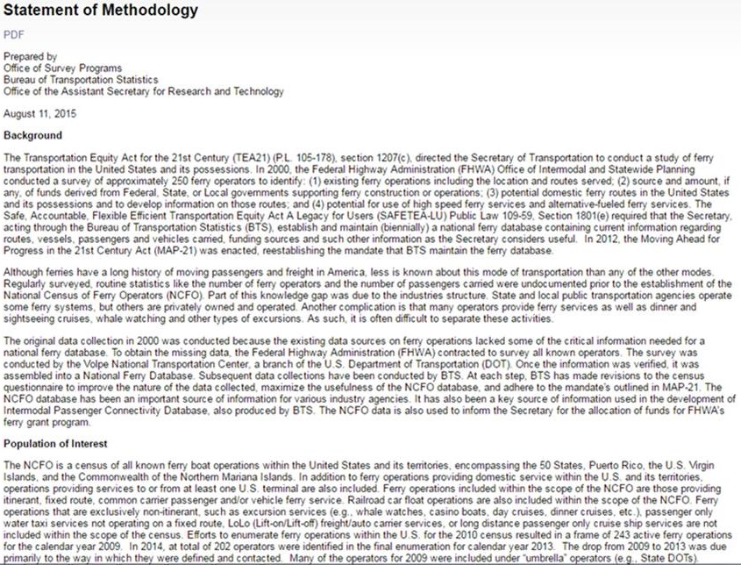
NCFO Website (Methods Page)

Slide 8
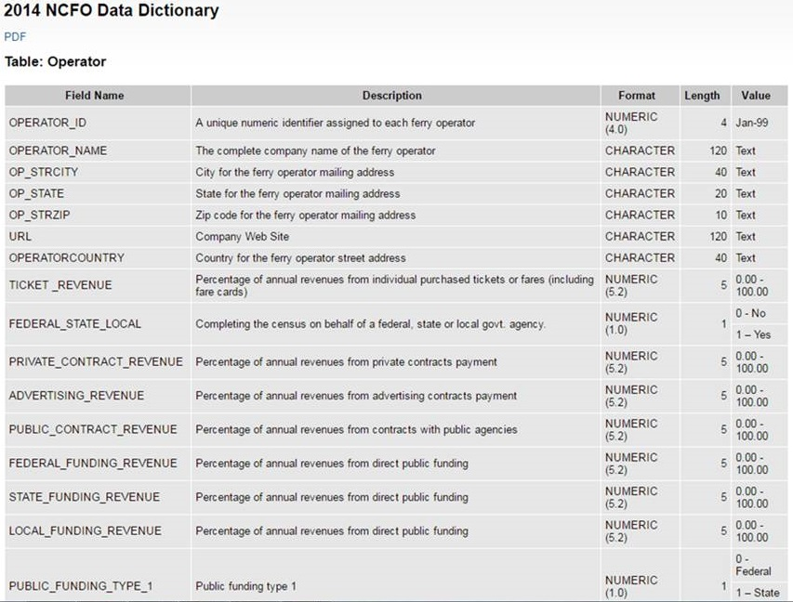
NCFO Website (Data Dictionary Page)

Slide 9
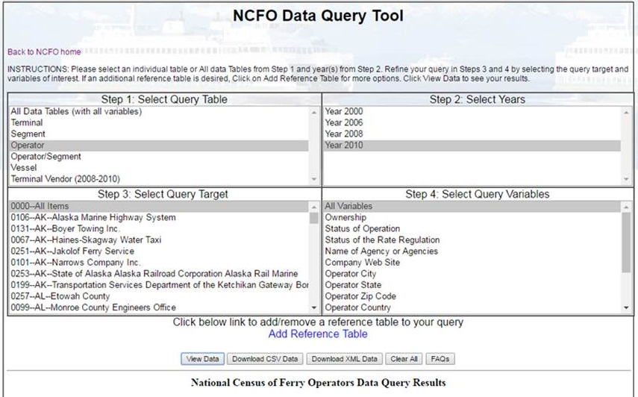
NCFO Website (Data – 2010 and Prior Years)

Slide 10
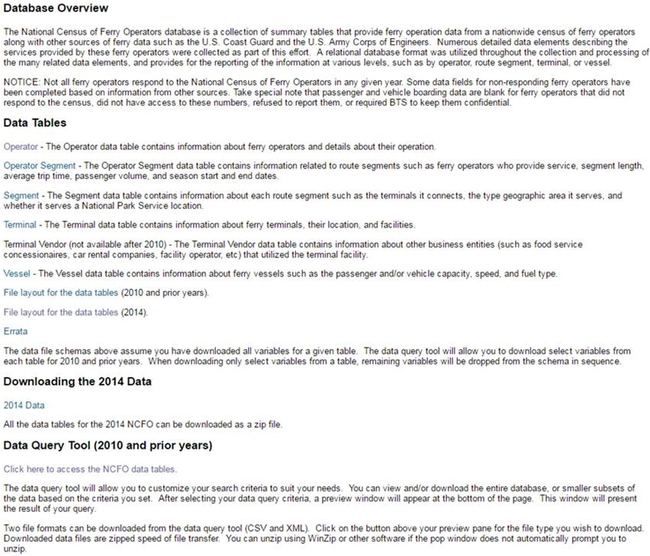
NCFO Website (Data – 2014)

Slide 11
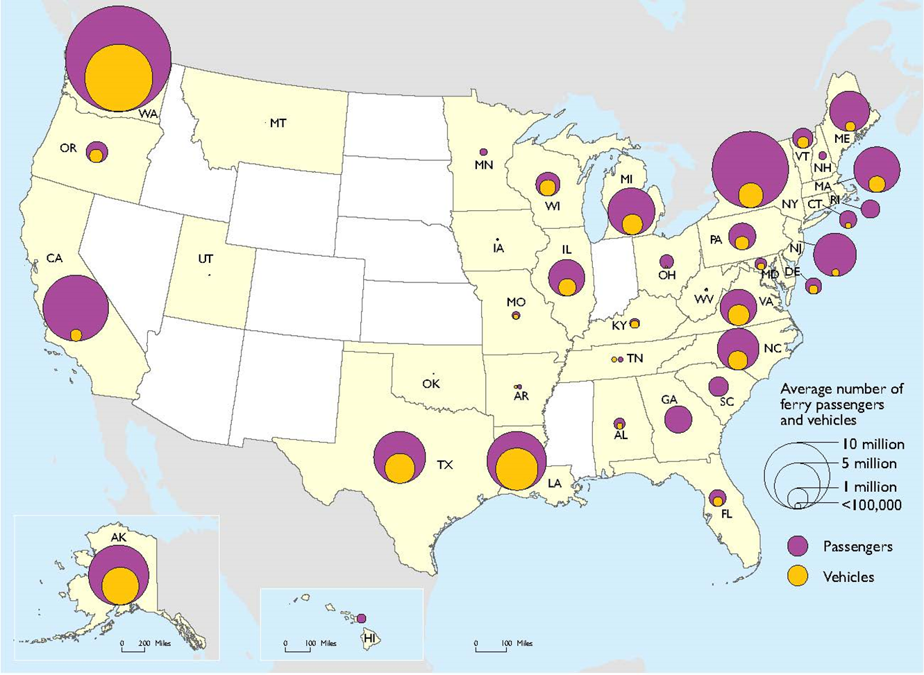
2013 Passenger and Vehicle Boardings

Slide 12
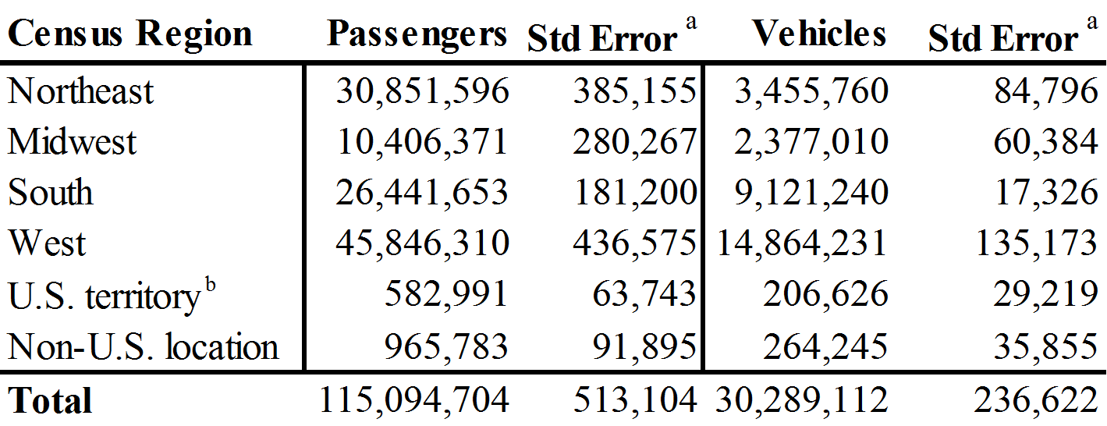
Boardings by Census Region (2013)

Slide 13
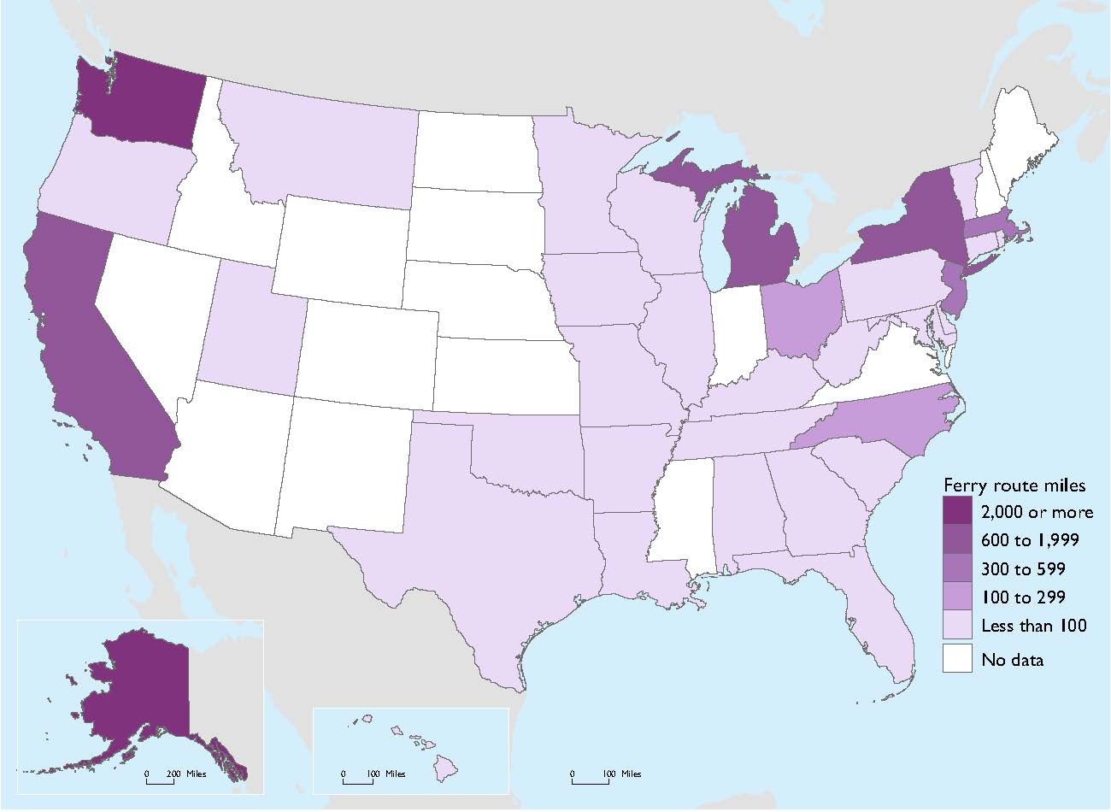
2013 Route Miles

Slide 14
Route Miles by Census Region(2013)

Slide 15
Comments / Questions
Thank You
Kenneth.Steve@dot.gov
202-366-4108

Slide 16
2016 Questionnaire Development
Reviewed the 2014 Form and Corresponding Data
Reformatted paper questionnaire
Modified question instructions and responses
Deleted two questions
Conducted Outreach to Data Users
Government agencies and the Passenger Vessel
Association
Made changes based on feedback
Pre-populated Questionnaires
Using available 2014 and 2010 operator responses

Slide 17
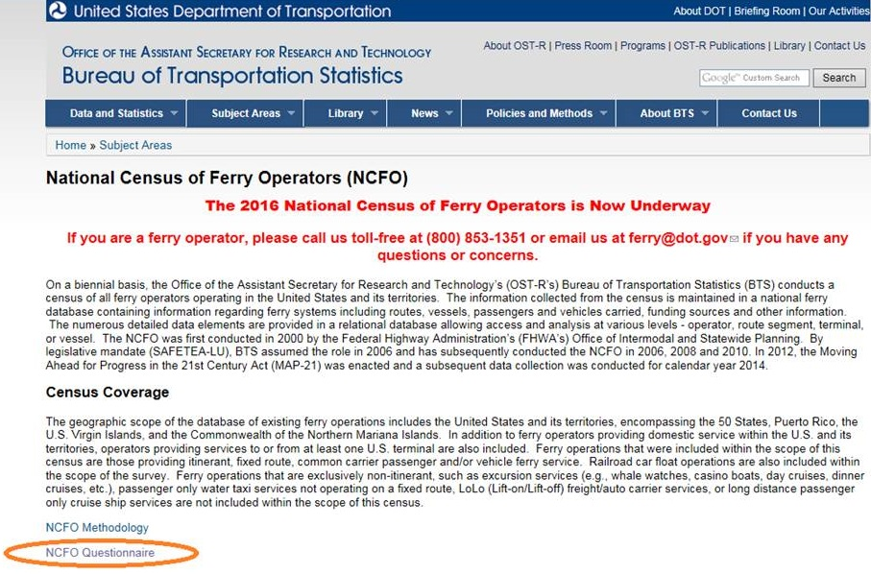
2016 Questionnaire

Slide 18
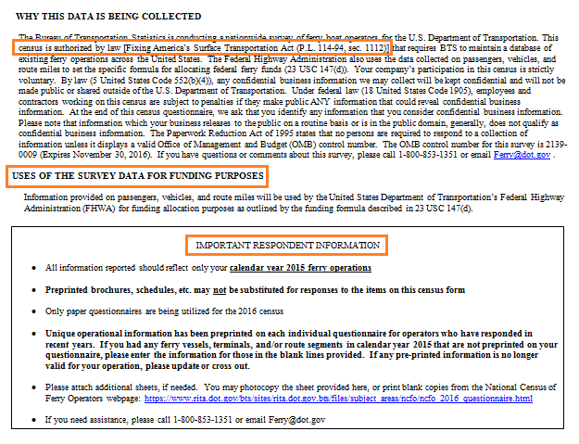
2016 Questionnaire Updates

Slide 19
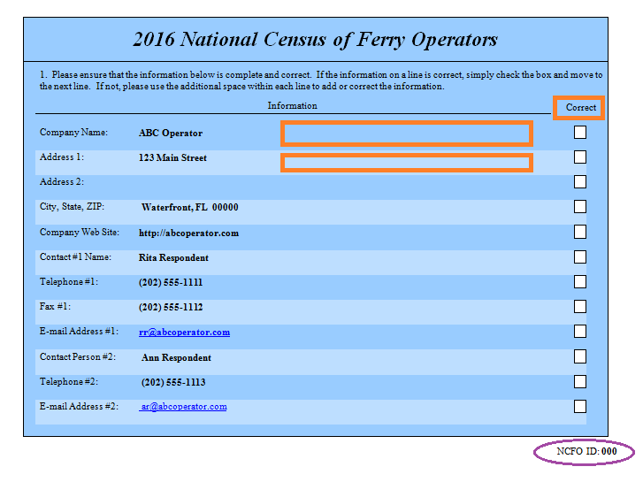
2016 Questionnaire Updates

Slide 20
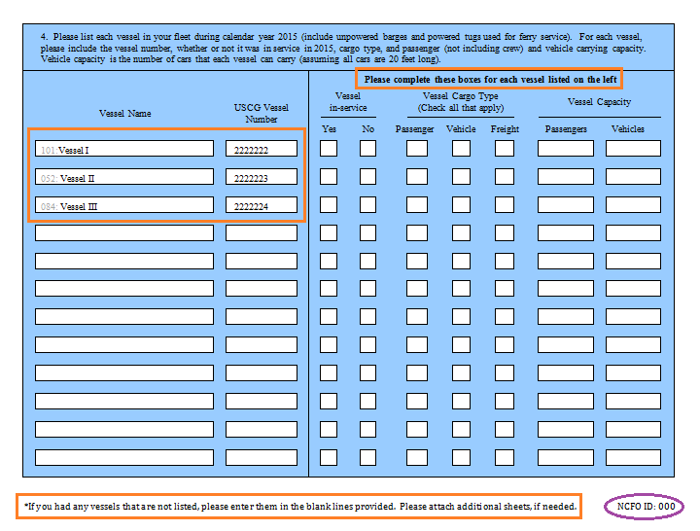
2016 Questionnaire Updates

Slide 21
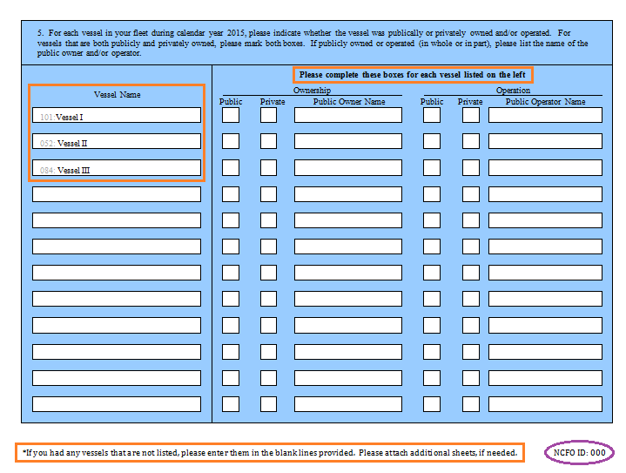
2016 Questionnaire Updates

Slide 22
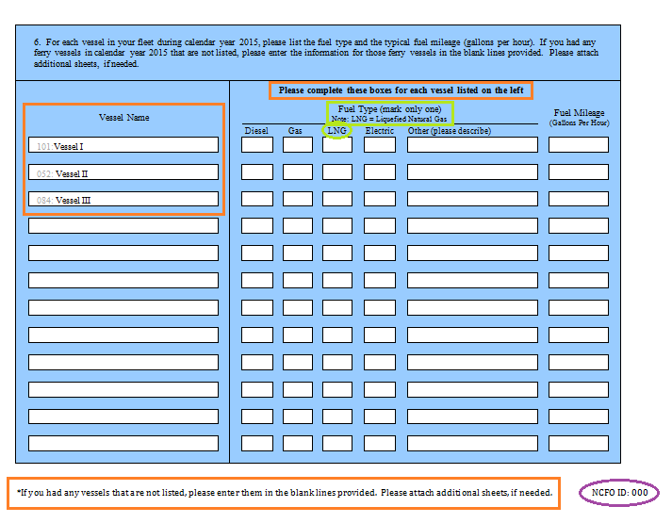
2016 Questionnaire Updates

Slide 23
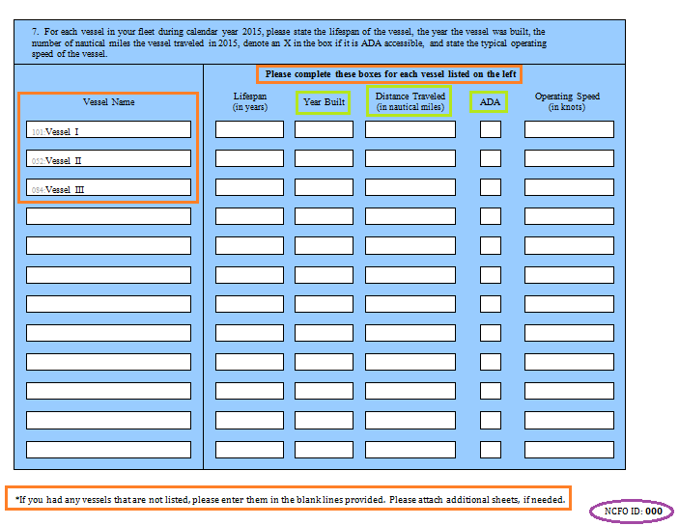
2016 Questionnaire Updates

Slide 24
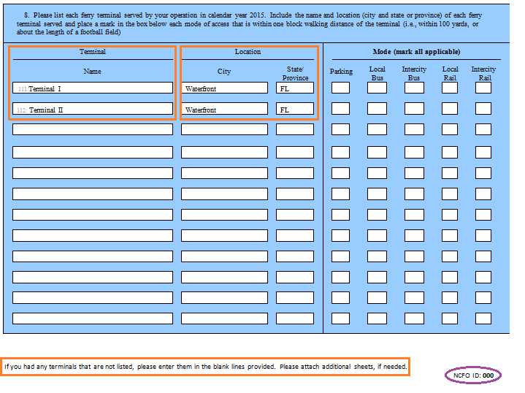
2016 Questionnaire Updates

Slide 25
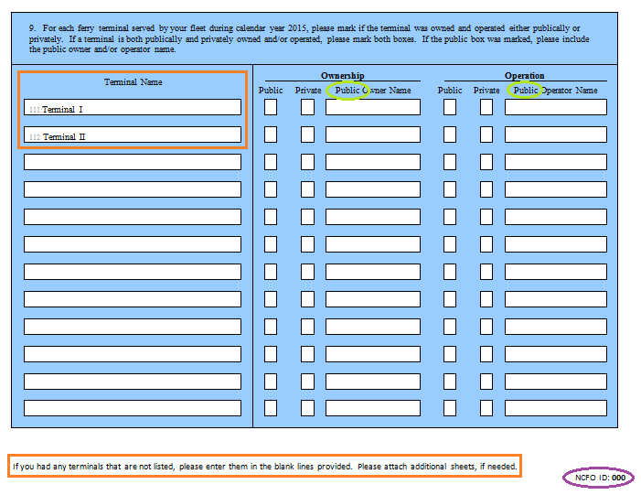
2016 Questionnaire Updates

Slide 26
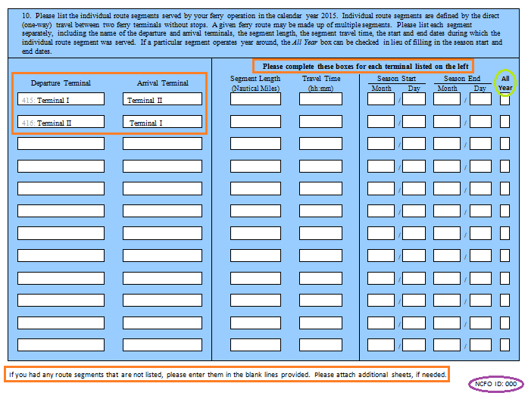
2016 Questionnaire Updates

Slide 27
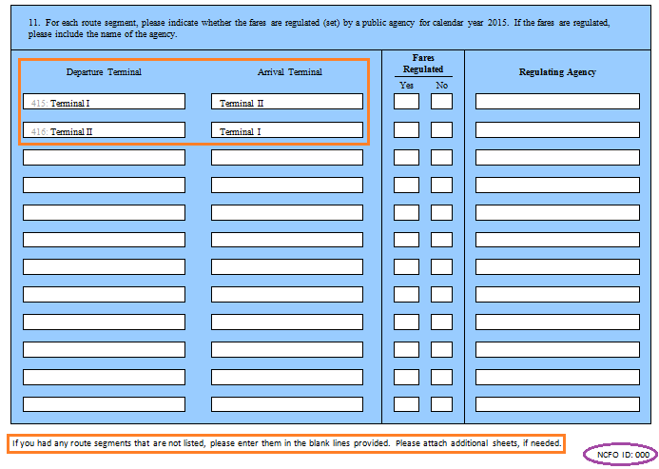
2016 Questionnaire Updates

Slide 28
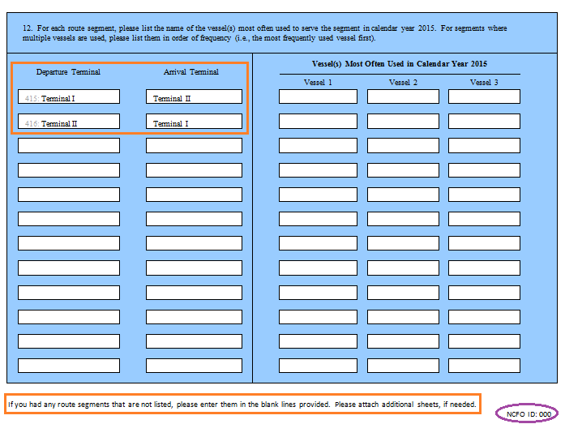
2016 Questionnaire Updates

Slide 29
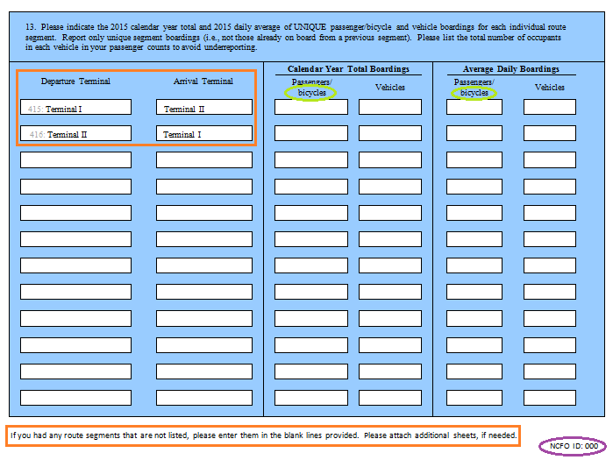
2016 Questionnaire Updates

Slide 30
Data Collection Timeline
Milestone | Date
E-mailed pre-notification letter | March 30, 2016
Mailed out census | April 4 – April 5
Conducted first round of non-response telephone follow-up | May 10-May 26
E-mailed non-respondent operators | June 6
Conducted second round of non-response telephone follow-up | June 6 – June 24
Conducting third round of telephone follow-up | July 18 – July 29

Slide 31
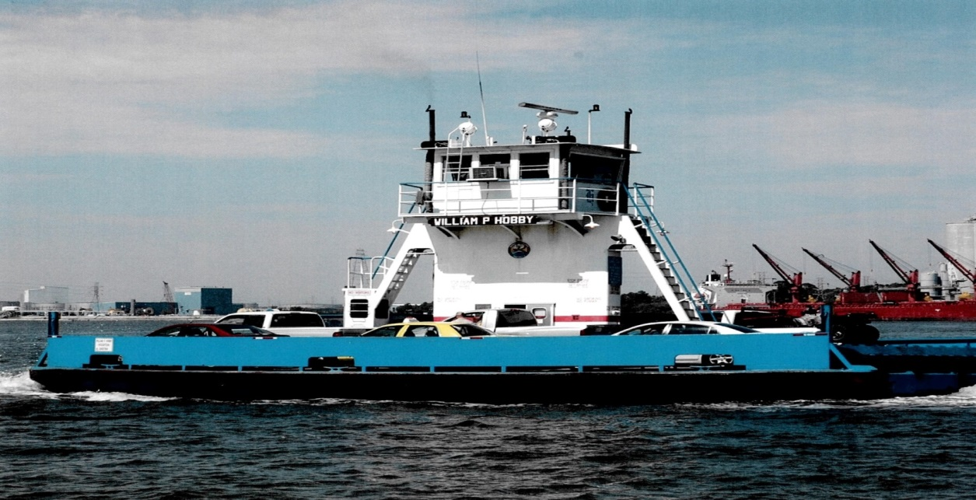
2016 Status Summary
Third Round of Telephone Follow-up On-going
65% response rate
Still receiving and accepting responses
Data Processing
Begins August 2016
Anticipated Data Release
Early 2017

Slide 32
Future
Fully electronic data collection tool
Web-based
User-friendly
Option for paper questionnaire, if preferred
New Database
Better and easier access to the data
New Webpage
Easier access to information, data, reports,
questionnaires, tables and images

Slide 33
Thank you!
Janine.McFadden@dot.gov
Ferry@dot.gov
1-800-853-1351
https://www.rita.dot.gov/bts/sites/rita.dot.gov. bts/files/subject_areas/ncfo/index.html

