Slide 1
Getting There:
Bikeshare Stations and
Their Connectivity
Bureau of Transportation Statistics

Slide 2
Intermodal Passenger Connectivity Database
Nationwide database of passenger transportation terminals, with data on the availability of connections among the various scheduled public transportation modes at each facility
Data can be downloaded in Excel or CSV from BTS website at http://www.transtats.bts.gov/
Notes:
BTS created and maintains the Intermodal Passenger Connectivity Database – called IPCD for short. The IPCD is a nationwide database of passenger transportation terminals, with data on the availability of connections among the various scheduled public transportation modes at each facility. The IPCD data includes passenger transportation terminals and stops with scheduled service for all modes and the locations of bike-share stations.
Scheduled airline service airports
Intercity bus stations (includes stations served by regular scheduled intercity bus service such as Greyhound and Trailways; code sharing buses such as “Amtrak Thruway” feeder buses; supplemental buses that provide additional frequencies along rail routes; and airport bus services from locations that are outside of the airport metropolitan area)
Intercity and transit ferry terminals
Light-rail transit stations
Heavy-rail transit stations
Passenger-rail stations on the national rail network served by intercity rail and/or commuter rail services
Bike-share stations belonging to bike-share systems that are open to the general public, IT-automated, and station based (contain hubs to which users can grab and return a bike)
The data elements describe the location of the above types of terminals as well as the availability of intercity, commuter, and transit rail; scheduled air service; intercity and transit bus; intercity and transit ferry services; and bike-share availability. Transit bus service locations are not specifically included in the database. However, the status of transit bus as a connecting mode is included for each bike-share facility in the database.

Slide 3
What is a Connection?
Facility connects when it is directly outside of another scheduled public transportation mode or within one block
Notes:
Give example of commuters grabbing bike-share outside of a heavy rail station to make final mile of trip to work.
Connections enable travelers to reach destinations served off the route of the mode last taken

Slide 4
Other Connections
IPCD indicates near connectivity to another mode when a facility or stop is between one and two blocks of another scheduled public transportation mode
No connectivity means that another scheduled public transportation mode serves the same metropolitan area (or city if in a non-metro area) but does not come within two blocks
No service means that the scheduled public transportation mode does not serve the same metropolitan statistical area (or city)
Notes:
Give example of commuters grabbing bike-share outside of a heavy rail station to make final mile of trip to work.
Connections enable travelers to reach destinations served off the route of the mode last taken

Slide 5
Sample Records
FACILITY_ID | ADDRESS | CITY | STATE | ZIP CODE | FACILITY_NAME | LONGITUDE | LATITUDE | FACILITY_TYPE | FERRY_ TRANSIT | BUS_ INTERCITY
DC2058001 | 5th & F St NW | Washington | DC | 20580 | 5th & F St NW | -77.019347 | 38.897222 | 12 | 3 | 0
DC2000107 | 450 F St NW | Washington | DC | 20001 | Judiciary Square | -77.017566 | 38.897211 | 9 | 3 | 0
0 = no connectivity but available in the metro- or micro-politan area (or city if not located in a MSA)
1 = connected
2 = near connectivity
3 = no connectivity and available in the metro- or micro-politan area (or city if not located in a MSA)

Slide 6
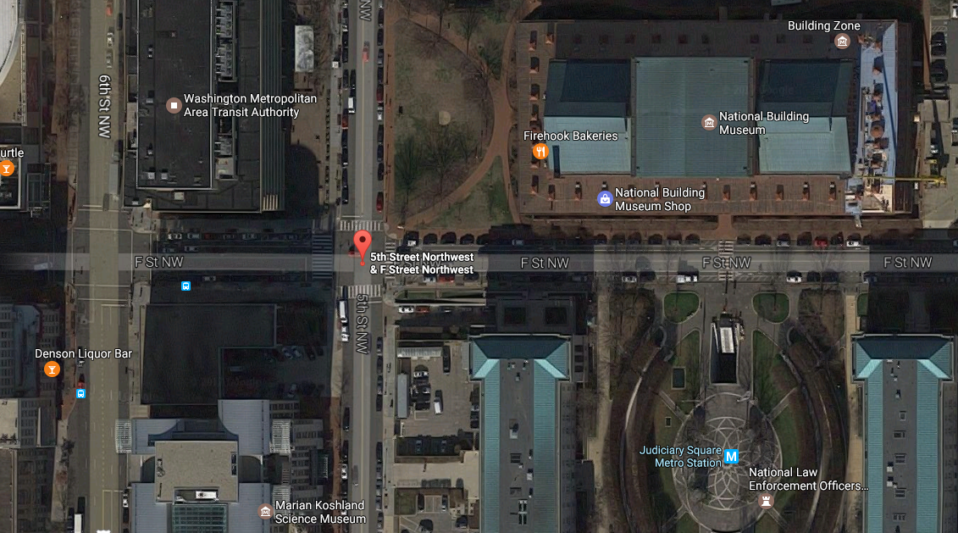
F St NW and 5th St NW, DC

Slide 7
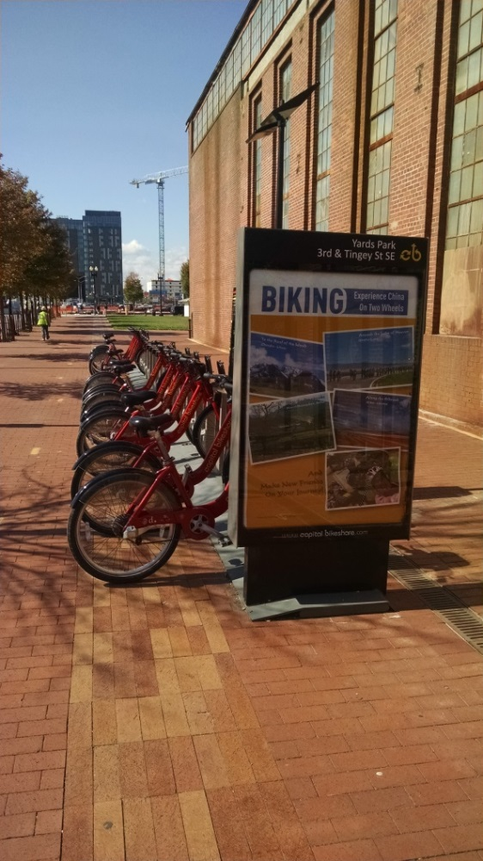
Bike-share
A bicycle (bike) sharing system is a service where bikes are available for shared use to individuals

Slide 8
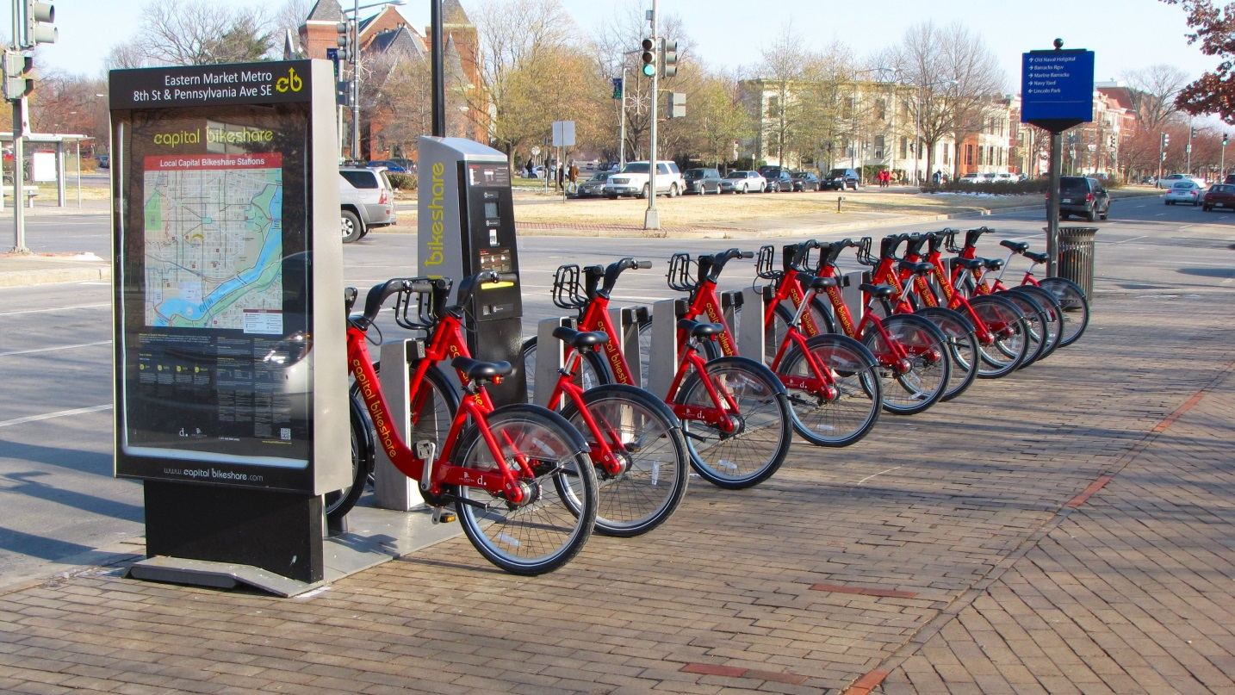
Bike-share in the IPCD
The IPCD includes bike-share systems open to the general public that are IT-automated and station based
3,982 U.S. bike-share stations
72 bike-share systems operate these stations
Notes:
In most cases, users of these systems pay a fee to grab a bike at any outdoor docking location (hub) in the system and then return the bike within a specified time limit to any outdoor docking location within that system. In some systems, users additionally may grab and return a bike to any bike rack (not part of a hub) within a specified geographic area. The IPCD includes the locations of the hubs in a system but not the individual bike racks that some systems allow for pick-up and drop-off of a bike.

Slide 9
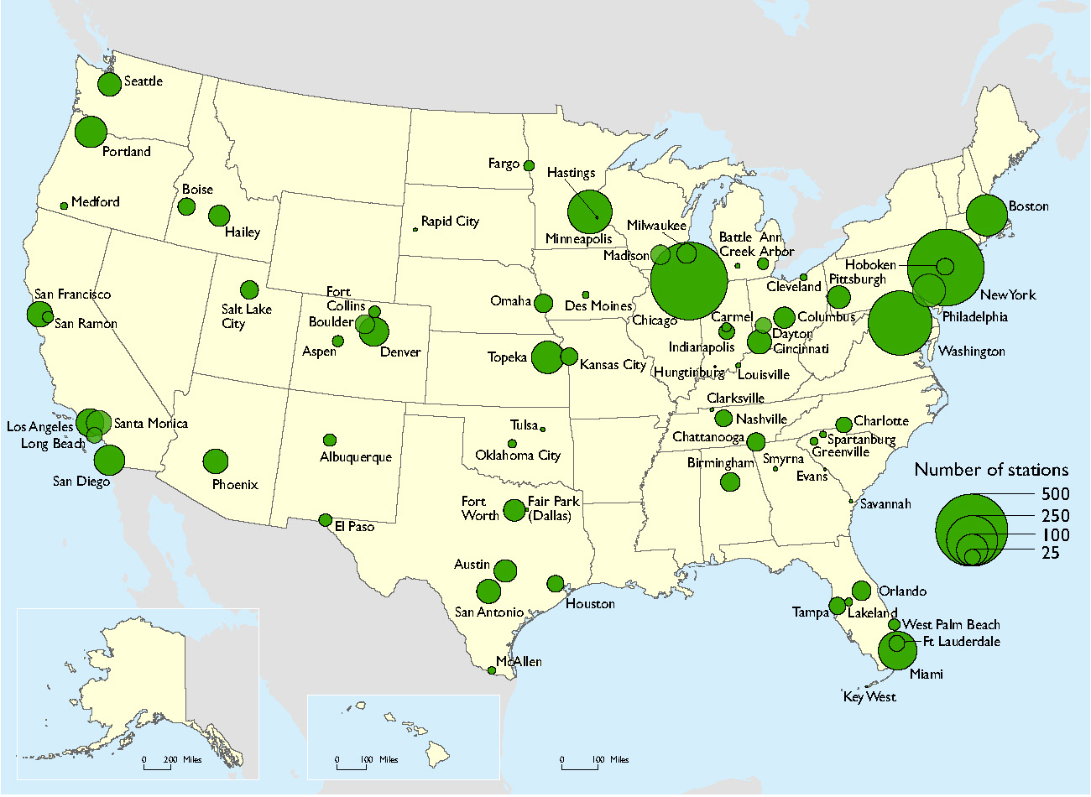
Cities with Bike-share
Bike-share operates in 124 U.S cities
13 systems operate across 1 or more cities within a metropolitan area
Notes:
As of October 2016. e.g., Capital Bikeshare serves 11 cities in the Washington DC-Arlington-Alexandria Metropolitan Area, and Cincinnati Red Bike serves 4 cities in the Cincinnati Metropolitan Area

Slide 10
Bike-share Connectivity
Notes:
In the United States, 75 percent of bike-share stations connect to another scheduled public transportation mode within 1 block, 13 percent connect within 1 to 2 blocks, and 11 percent either have no connection or no connection to a scheduled public transportation mode within 2 blocks
A bike-share station nearly connects to another mode when it is between one and two blocks of another scheduled public transportation mode

Slide 11
Modes Bike-share Connects to
75 percent bike-share stations connect with transit modes (transit bus, transit rail, and transit ferry)
Notes:
Bike-share predominately connects with other transit modes (transit bus, transit rail, and transit ferry); only 2 percent connect with intercity mode (intercity ferry, intercity bus, intercity rail, and/or air)
--Bike-share connects the most frequently with transit bus. 75 percent of bikeshare stations connect with transit bus, additional 14 percent nearly connect

Slide 12
Transit with Bike-Share Connectivity
Looking a cities with availability…
Notes:
-In cities served by commuter rail and bike-share, 25 percent of the stations served by commuter rail connect with a bike-share station
-In cities served by heavy rail and bike-share, 36 percent of the stations served by heavy rail connect with a bike-share station
-In the cities served by light rail and bike-share, 21 percent of the stations served by light rail connect with a bike-share station
-In cities served by transit ferry and bike-share, 44 percent of transit ferry terminals connect with a bike-share station

Slide 13
Contact Information
Theresa Firestine, Senior Economist
U.S. Department of Transportation
Bureau of Transportation Statistics
theresa.firestine@dot.gov
202-366-3629

