Slide 1
FHWA Support for Bicycle
(& Pedestrian) Counting
Jeremy Raw, P.E.
Office of Planning
Federal Highway Administration
April 25, 2017
BTS Behind the Numbers: Bicycle Counting

Slide 2

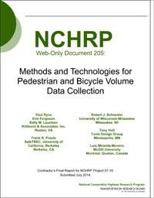
NCHRP Guidance on Counting
NCHRP
Report 797
Web-Only Document 205

Slide 3
NCHRP Guidance on Counting
NCHRP
Report 797
Web-Only Document 205
http://onlinepubs.trb.org/onlinepubs/nchrp/nchrp_rpt_797errata.pdf

Slide 4

Bike/Ped Count Technology Pilot
What does it take to start a program?
Funded 10 agencies ($20K each)
Documentation
Technical support
https://www.fhwa.dot.gov/environment/bicycle_pedestrian/countpilot/

Slide 5
Bike/Ped Count Pilot Locations

Slide 6
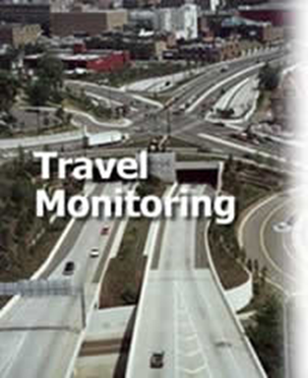
Traffic Monitoring Analysis System
National database of counts
Standard data format
Consistent quality checks
Goals:
  Monitor Trends
  Support Research (e.g. Forecasting, Safety)
  Transportation System Performance Management
https://www.fhwa.dot.gov/policyinformation/travelmonitoring.cfm

Slide 7
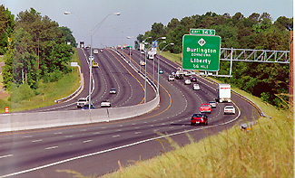
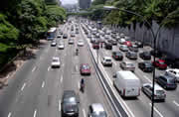
TMAS Motorized
All automated motorized counts across US
Basis for FHWA Traffic Volume Trends
Complements Highway Performance Monitoring System (HPMS)
Data submitted monthly by each State DOT

Slide 8
TMAS Non-Motorized
Not (yet) a comprehensive database
Any agency can submit (not just State DOTs)
User account required
Open for submissions within 2017
Pilot testing underway in June

Slide 9
TMAS Data Submission
Data in Traffic Monitoring Guide Format
Quality Checking is comprehensive
  No garbage allowed!
Data must pass the checks to get in
  Initially, err in the direction of allowing data
  “Questionable” data will be flagged

Slide 10
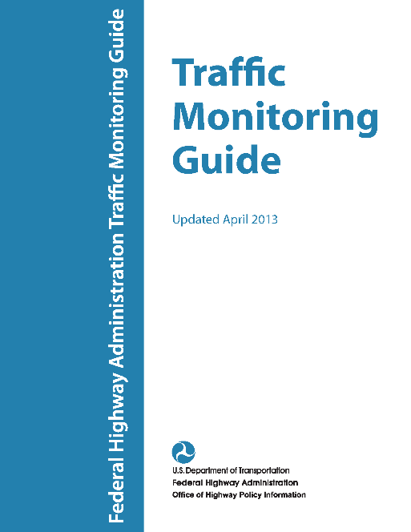
Traffic Monitoring Guide Data Format
Definitive Formats for Motorized and Nonmotorized Data
All data for TMAS must be in these formats
Nonmotorized format is concise, flexible, powerful…
Updated: October 2016

Slide 11
Traffic Monitoring Guide Data Format
Definitive Formats for Motorized and Nonmotorized Data
All data for TMAS must be in these formats
Nonmotorized format is concise, flexible, powerful…
And “difficult”
Updated: October 2016

Slide 12
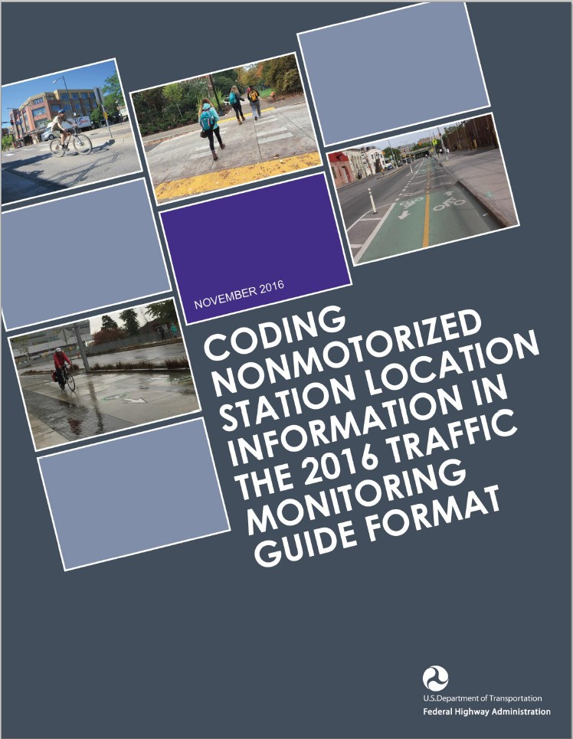
Guidebook on TMG Format
Count station description (location)
Count data
Collecting multiple counts at single location
Facility types and counting examples
2

Slide 13
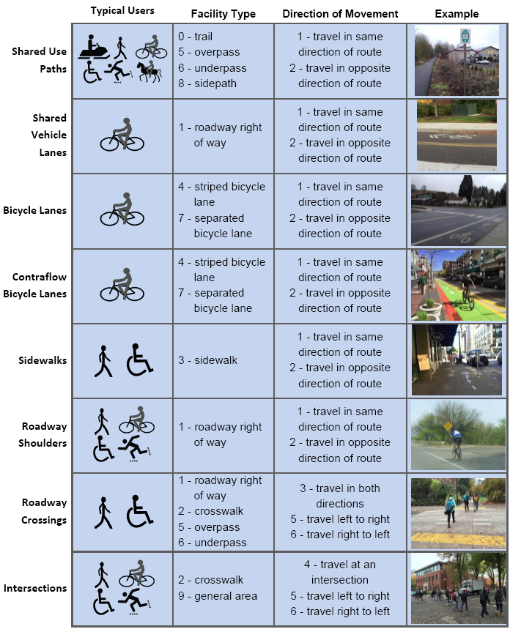
Station Location Examples
Guidebook includes 29 examples organized by type
Provides guidance specific to each example type
13

Slide 14
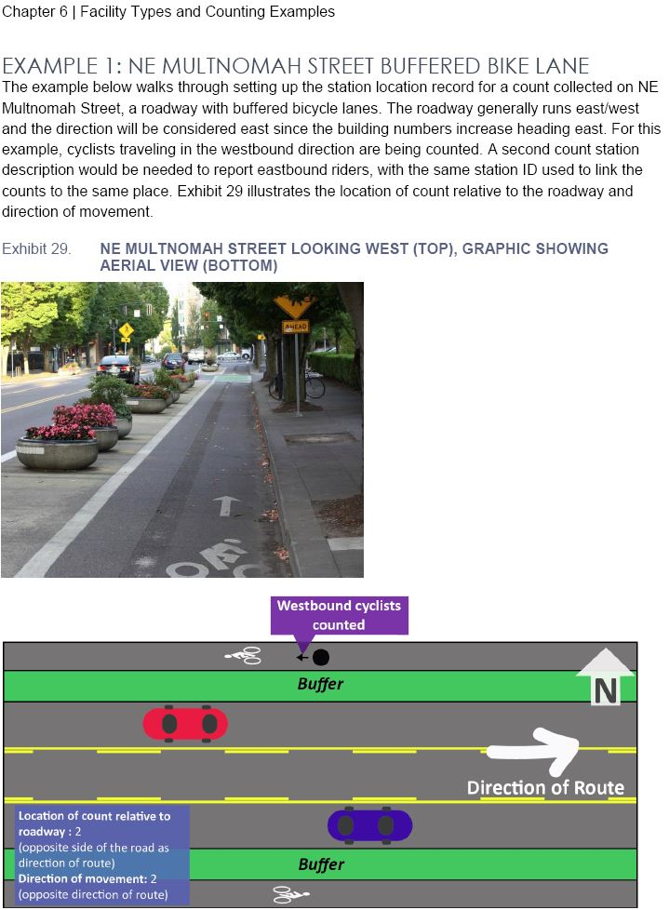
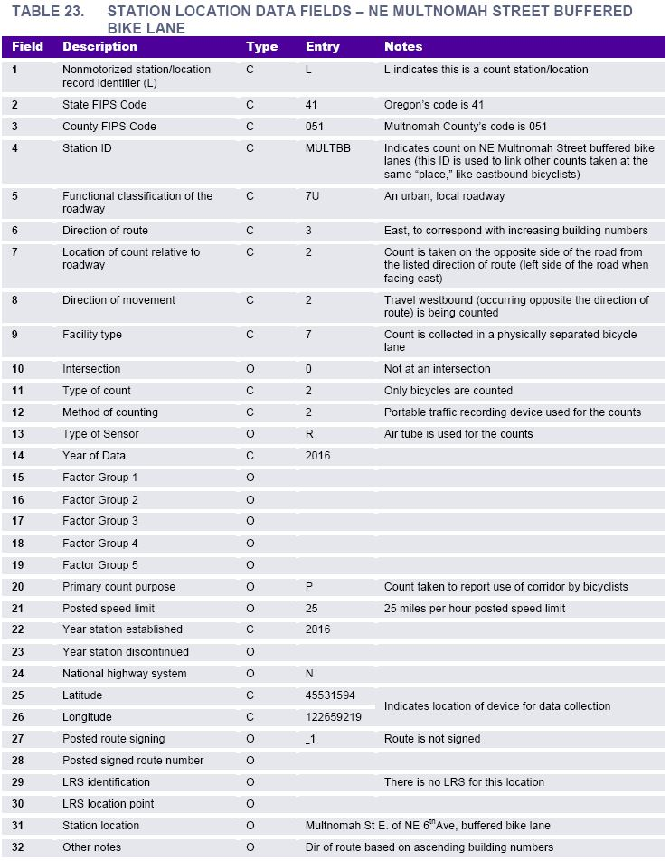
Station Location Examples
14

Slide 15
What Will We Do with Counts?
Performance Measures
Research
Bicycle Traffic Trends
Facility Before-and-After Utilization
Safety Risk and Exposure
Forecasting Facility Use

Slide 16
Looking Ahead
Public Access to the Data (initially on request)
Bicycle Network Data Collection
Integration with All-Roads Network and HPMS
System-wide Travel Estimates

Slide 17
Links to Useful Documents
NCHRP Reports 797 and Online Only 205
  http://www.trb.org/Main/Blurbs/171973.aspx
Count Technology Pilot Project
  http://www.fhwa.dot.gov/environment/bicycle_pedestrian/countpilot/
Traffic Monitoring Guide
  http://www.fhwa.dot.gov/policyinformation/tmguide/
Coding Data in the TMG Format
  http://www.fhwa.dot.gov/environment/bicycle_pedestrian/publications/tmg_coding/

Slide 18
TMAS Contacts at FHWA
Steven Jessberger (Highway Policy Information)
steven.jessberger@dot.gov
202-366-5052
Jeremy Raw (Office of Planning)
jeremy.raw@dot.gov
202-366-0986

