Slide 1
DVRPC
Office of Travel Monitoring
Bicycle / Pedestrian Program Summary
U.S. DOT Bureau of Transportation Statistics Webinar April 25, 2017

Slide 2
Data Types
Vehicle Volume
Bicycle Volume
Vehicle Classification
Bicycle Permanent
Vehicle Manual Classification
Pedestrian Volume
Vehicle Turning Movement
Pedestrian Permanent
Vehicle Speed
Crosswalk
Vehicle 8-Day
Vehicle Loop
Transportation System User Surveys
Notes:
Star = new type in last 2 yearsStar = new type in last 2 years.
Crosswalk is taken as Video.
Permanent is 15 locations.
All Types in 15 min increments.

Slide 3
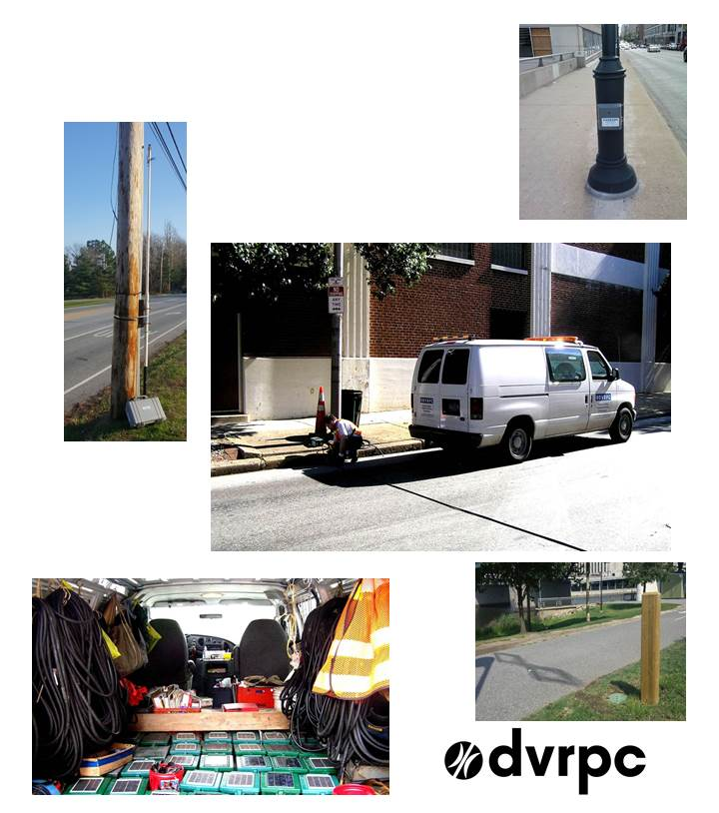
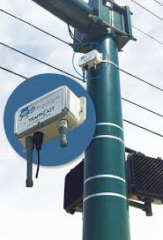
Equipment
Pedestrian
Counter
Bicycle
Counter
Equipment Van
Bluetooth
Microwave Radar
Video
Vehicle Counters,
Pneumatic Tube,
and Supplies
Permanent
Bicycle / Pedestrian
Counting Station
Notes:
Microwave Radar = Major Interstates like I-76 or I-95. Usually obtained/monitored by another entity (DoT or Private).
Traffic.com

Slide 4
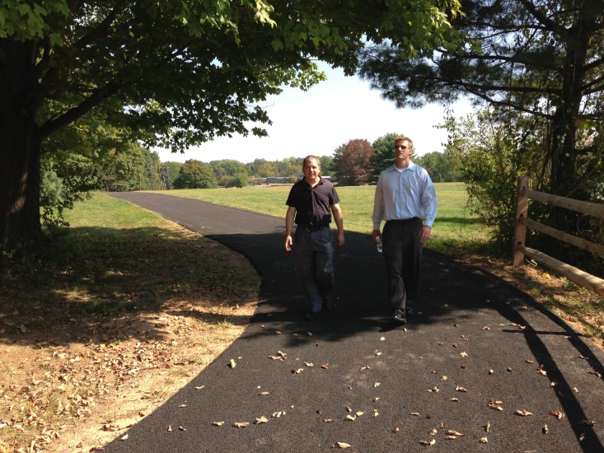
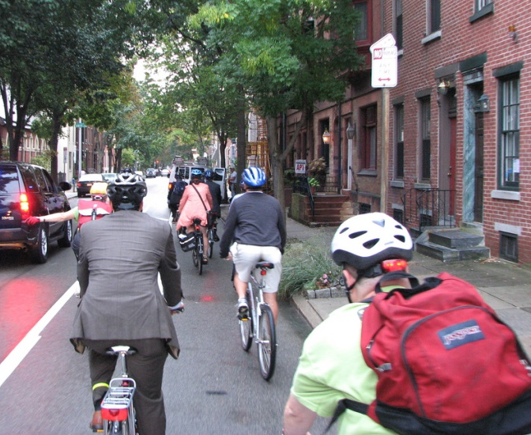
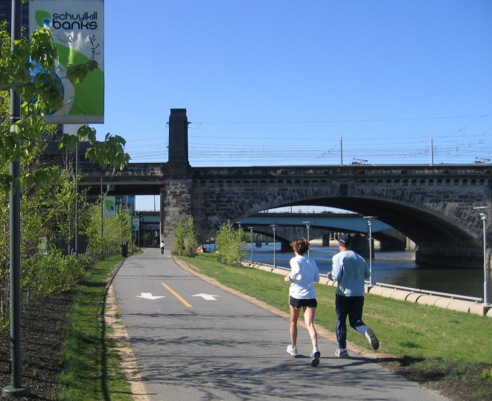
A Multi-Pronged Approach to Cyclist and Pedestrian Counting
The FHWA Traffic Monitoring Guide identifies three main types of count programs
Permanent Count
Program
Cyclical Count
Program
Project
Counts
Notes:
So how do we count?
DVRPC has a relatively long history of bicycle and pedestrian counting. In the past this has taken the form of short-term counts, often a week-long, to document activity along the region’s trails, bike-lanes, and sidewalks. But, over the last two years, DVRPC has launched a multi-faceted program to take these counts to the next level. The new program features:
Permanent counters providing continuous data,
A large set of recurring week-long counts which will be taken at the same locations every three years.
Permanent, continuous counts ongoing data for the locations in which they are deployed, but they also allow for the development of region-specific seasonal adjustment factors. When applied to week-long counts, these adjustment factors help us estimate total annual traffic and average daily traffic.
The large set of recurring counts will allow DVRPC will give us a comprehensive overview of activity of the region and let us track trends in specific parts of the region.
Non-recurring week-long counts will continue as needed to support specific projects and studies.

Slide 5
Permanent Count Program
Consists of sites where data is collected 24 hours a day, 365 days a year.
These sites are organized into “factor groups” whose locations have similar travel characteristics.
Data is used to develop seasonal correction factors, which when applied to short term counts yield AADB & AADP, the correlative to AADT.
Notes:
All three legs are decided by a collaboration of advocacy groups, stakeholders, our agency and planning partner agencies, and public groups.

Slide 6
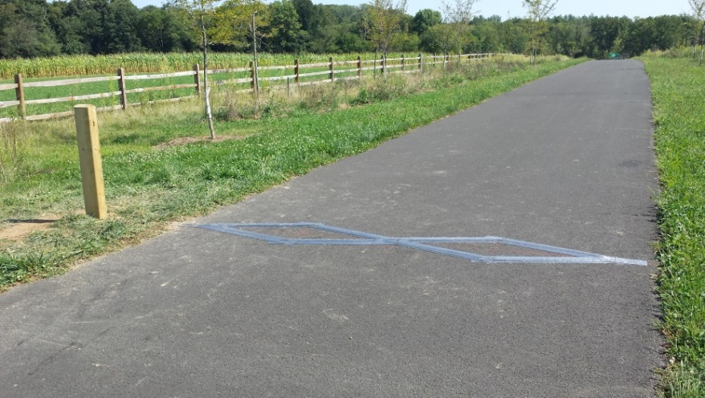
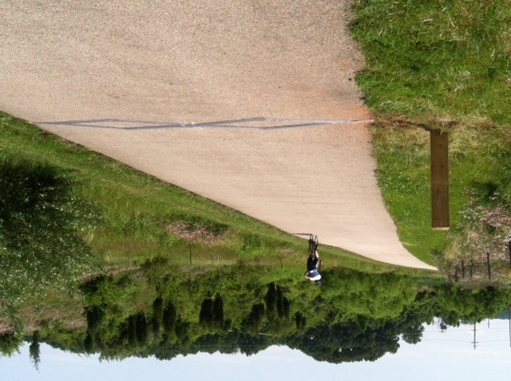
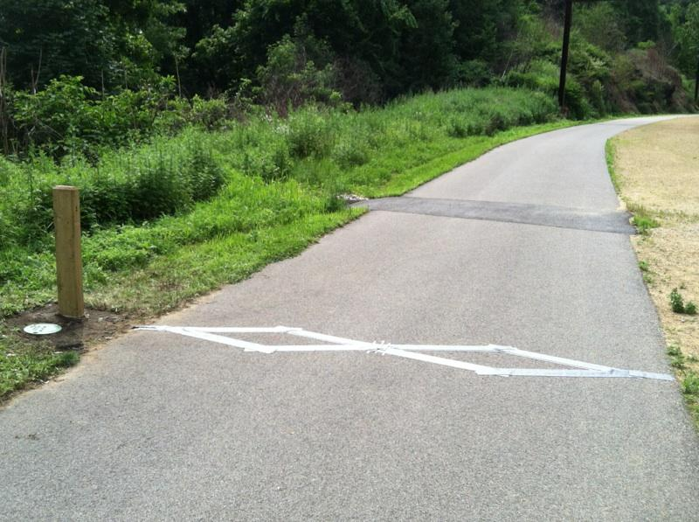
Permanent Bicycle and Pedestrian Counters
DVRPC installed 15 permanent counters on multi-use trails
Counters use an infrared sensor and inductive loop to detect and distinguish bicycles from pedestrians
Counters collect data continuously 365 days a year, 24 hours a day and wirelessly report data in 15 minute increments by direction and by mode
Notes:
To implement this program, DVRPC acquired and installed 12 permanent bicycle and pedestrian counters on multi-use trails in the region. This acquisition was generously supported by the William Penn Foundation. These counters, all acquired from EcoCounter, collect and report data continuously throughout the year in fifteen minute increments by direction by mode. They use a combination of an infrared sensor and an inductive loop to detect and distinguish bicycle and pedestrian traffic.

Slide 7
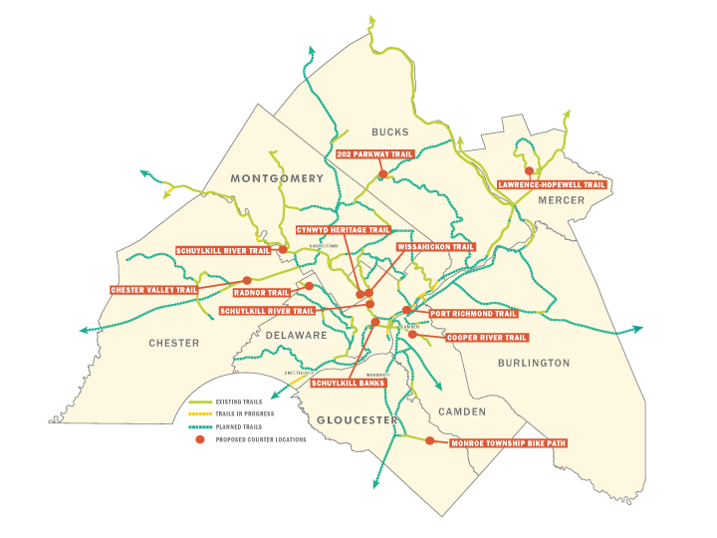
Trail Permanent Count Stations
12 locations, counting 24 hours a day, 365 days a year.
Notes:
Initial 12 counters

Slide 8
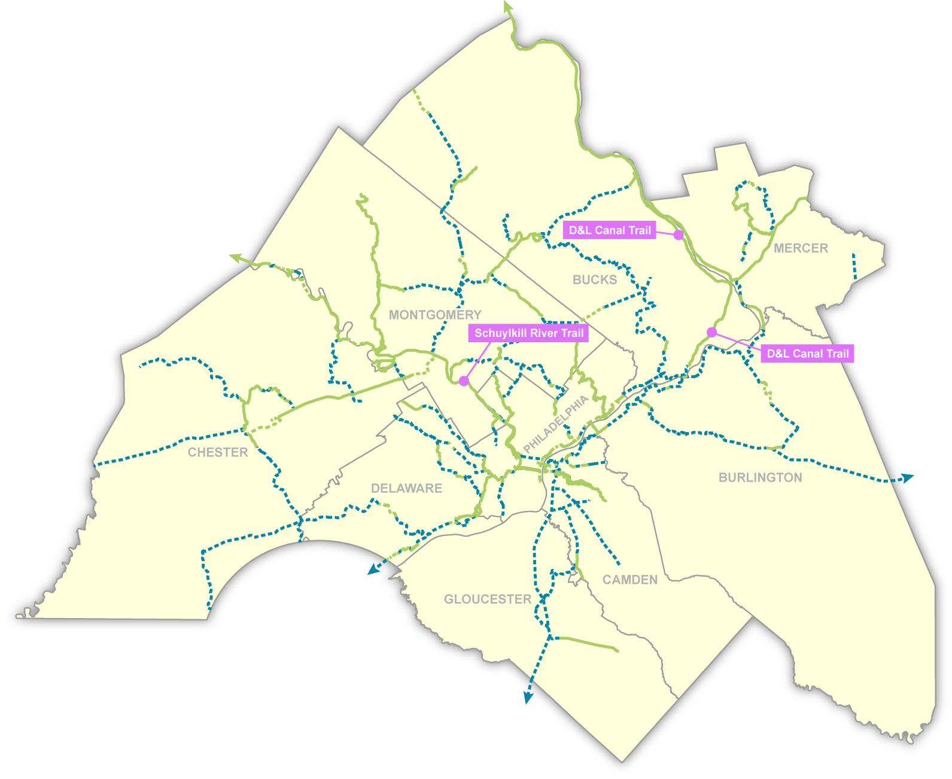
Trail Permanent Count Stations
3 locations, sponsored by Pennsylvania Environmental Council
Notes:
PA Env Council locations – 2 are soil trails, 1 on pavement.

Slide 9
September 1, 2015 -- August 31, 2016

Slide 10
Cyclical Count Program
Consists of sites that are counted on a cyclical basis – generally a three year rotation.
Week long counts are collected, with raw data adjusted to AADB & AADP based on the seasonal factors provided by data from the permanent sites.
Data is used to track trends, either in mode share or at a specific site.
Notes:
140-150 locations.
Mobile counters – 1 week
Can use an app with bluetooth to obtain data

Slide 11
Cyclical Counting Program Locations
Notes:
Vehicle cyclical counts is standard practice.
See usage and patterns/trends over time
3 year cycle.

Slide 12
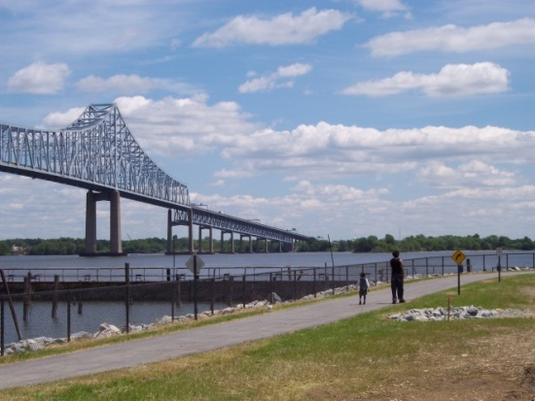
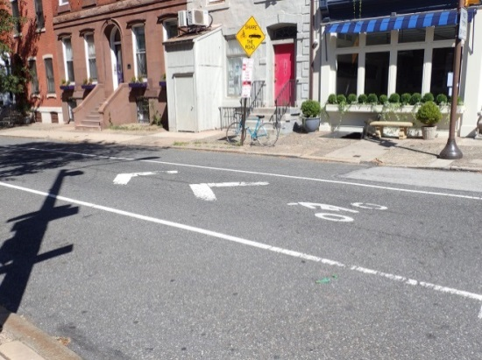
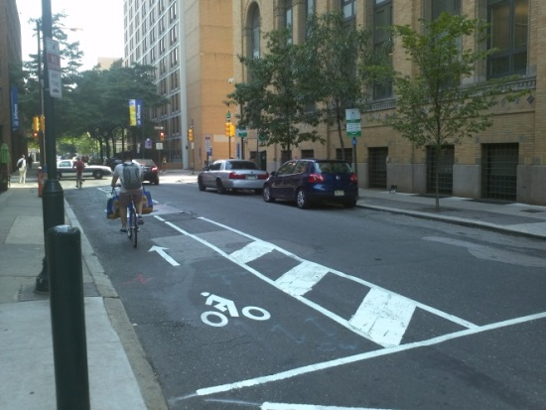
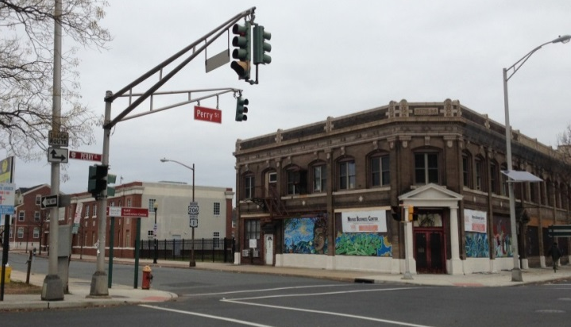
Types of Facilities
Trail or Sidepath
Striped Shoulder
Sharrow
Bicycle Lane
Mixed Traffic

Slide 13
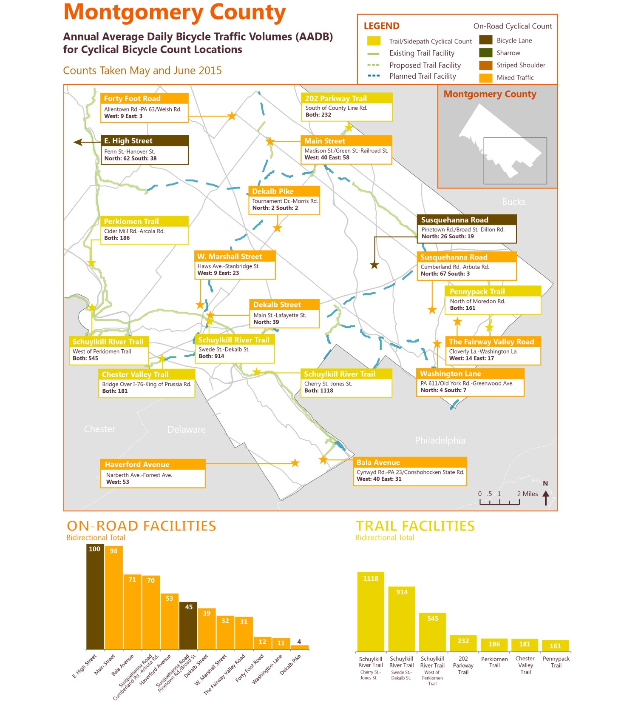
Bicycle Cyclical Program -- Montco Results
Notes:
Example area of the mix of count types for cyclical program – Lower Mont Co.

Slide 14
Change over Time
Center City, Philadelphia
+57%
+53%
2010
589
2015
925
2011
766
2015
1173
Notes:
Just happened to have the 2010/2011 counts from a previous project.
Example of showing trends.

Slide 15
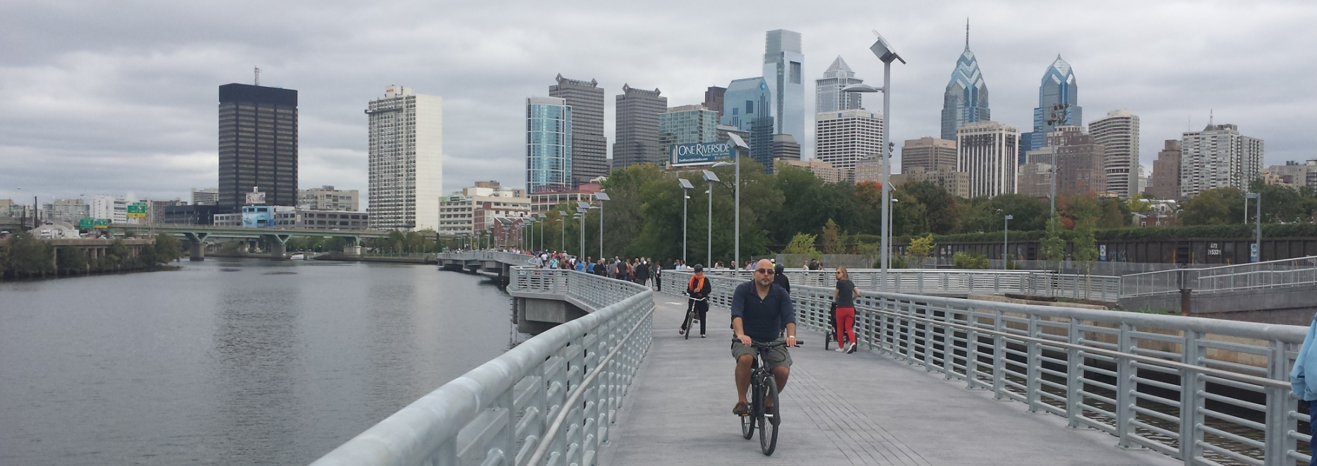
Project Counts
Notes:
Brady loves this picture. It’s a great picture of the recently opened Schuylkill River/South St boardwalk. Opened in Oct 2014.

Slide 16
Project Counts
Consists of sites that are counted for a specific project or purpose.
Week long counts are collected, with raw data adjusted to AADB & AADP based on the seasonal factors provided by data from the permanent sites.
Data is used to establish facility use.

Slide 17
Project Counts – Continued
This type of count has been performed by the Office of Travel Monitoring for over six years.
Projects include before / after studies of Tiger Grant funded projects, counts for the City of Philadelphia Department of Health, periodic trail counts, even Old City “First Friday” tracking of pedestrian volumes.
To date, over 2,000 of these short duration counts have been completed.
Notes:
Other events: The Papal visit & DNC this past fall, SEPTA strike & other transit changes.

Slide 18
Cynwyd Heritage Trail Oct 19 – Nov 8, 2015
Notes:
An example of data before and after a change/major opening.
Not mobile counters.

Slide 19
Cynwyd Heritage Trail Oct 19 – Nov 8, 2015
Manayunk Bridge Trail Opens

Slide 20
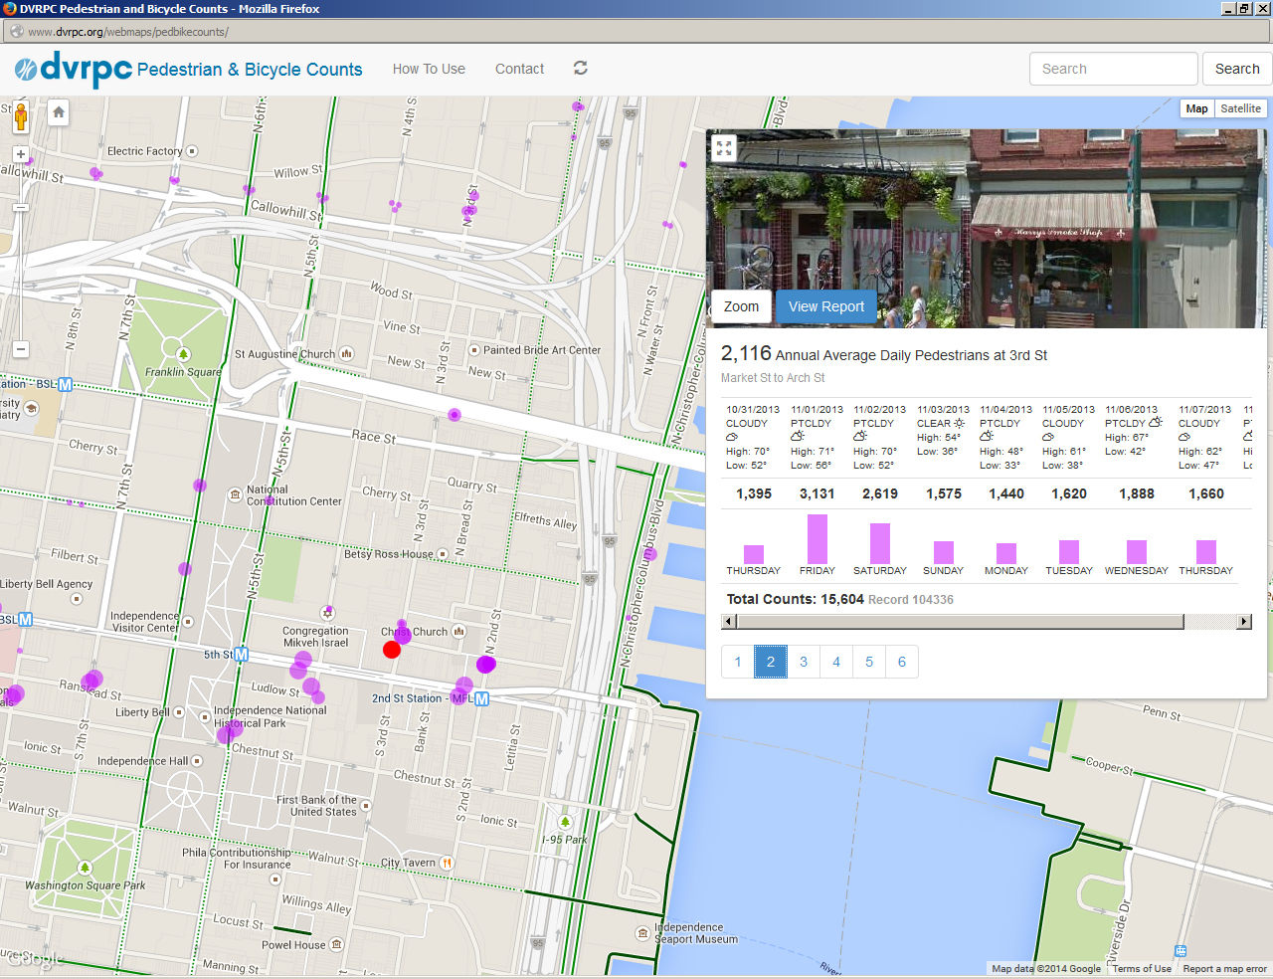
Bicycle / Pedestrian Web Viewer
Notes:
Just discuss briefly
Can find at: DVRPC website>Data & Products>Products> Interactive Maps
Purple = Peds, Orange = Bikes. Shows multiple counts over the years & includes weather and other supporting information.
Includes Google Streetview – Very nice, but at times the picture is not mode centric.

Slide 21
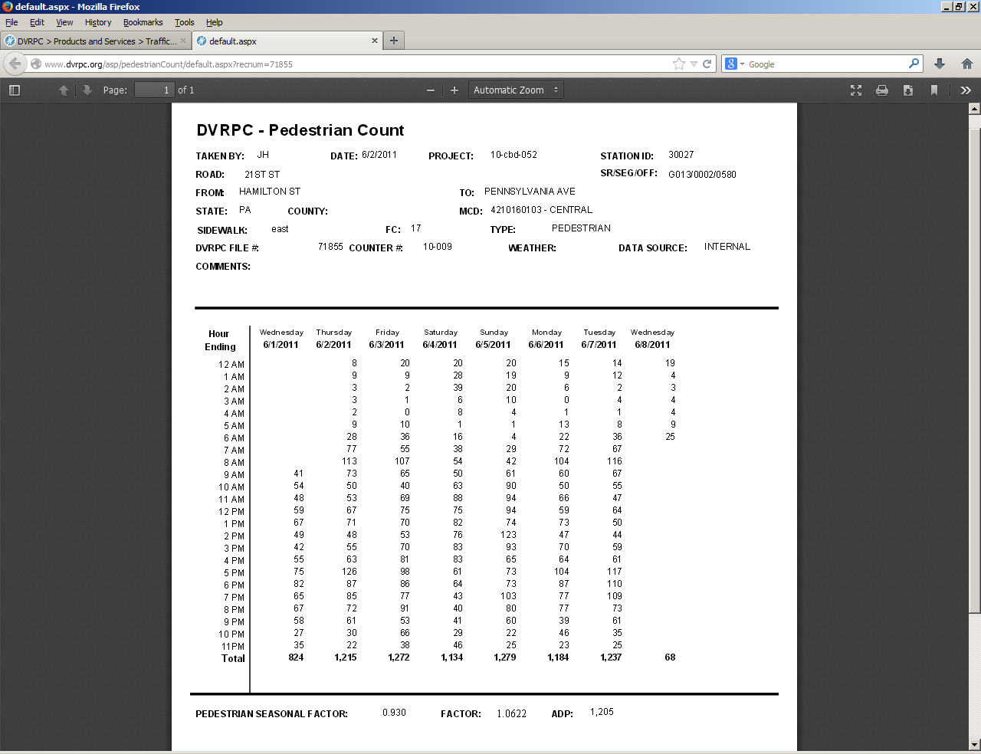
Notes:
Basic example of data after you select via the web viewer.

Slide 22
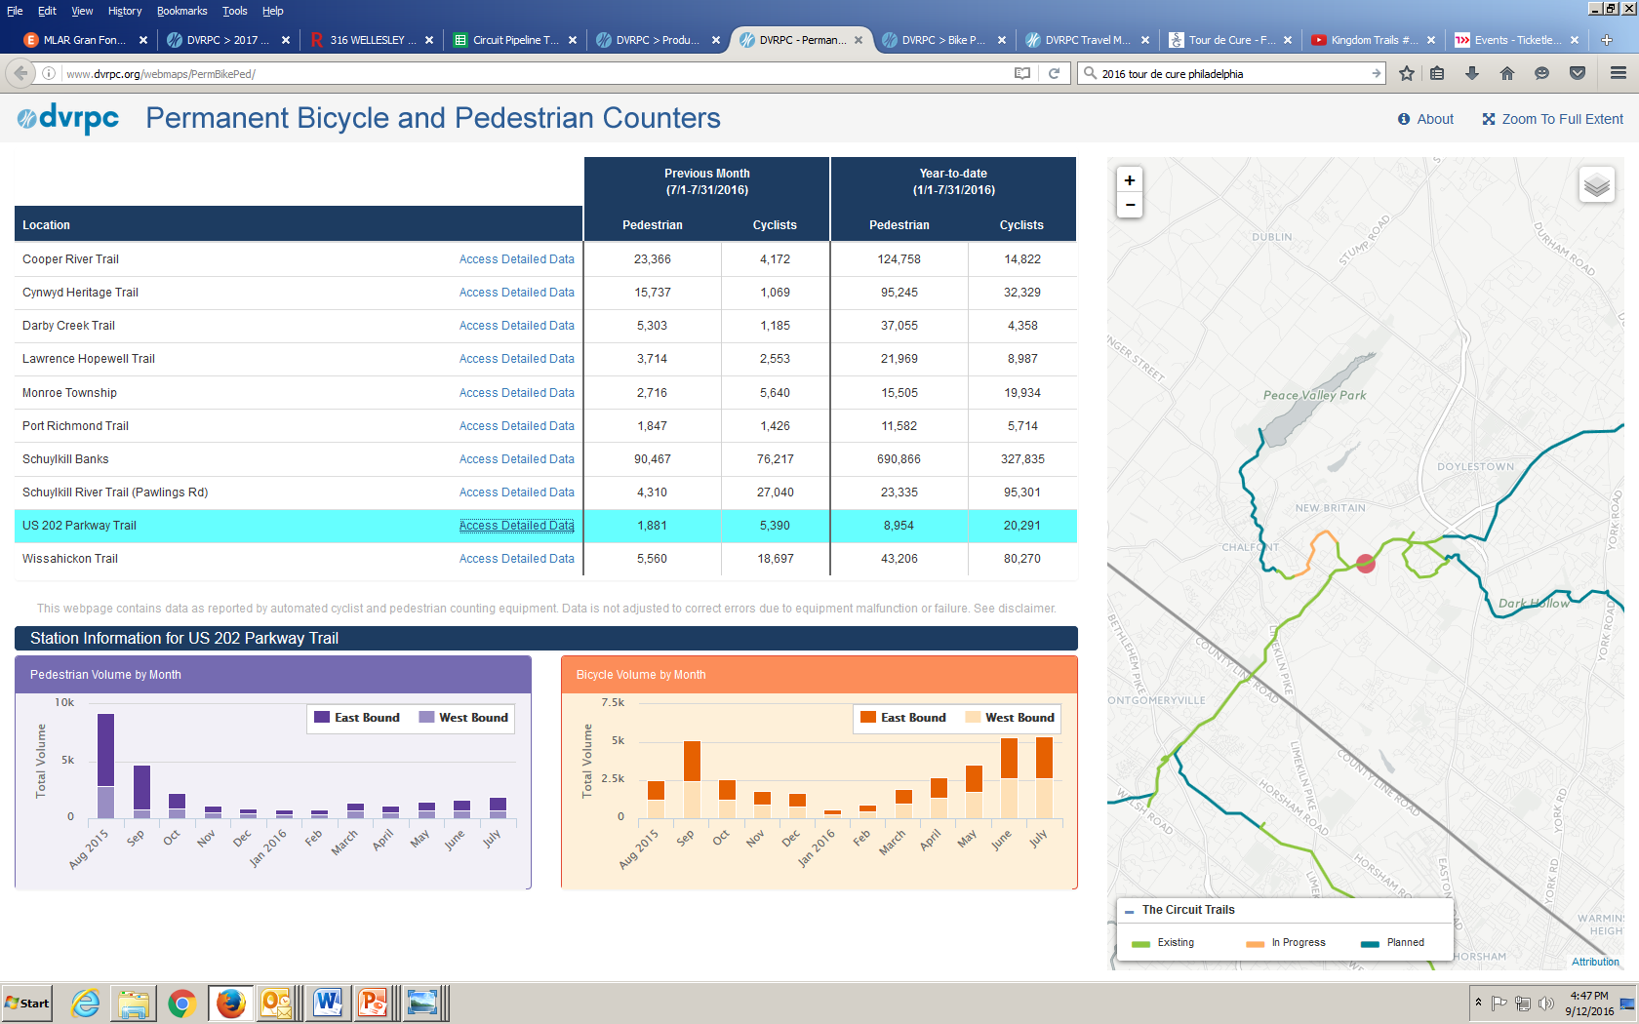
Permanent Station Web Viewer
Notes:
Lists the permanent sites. Shows previous month & year to data summaries. Both are by mode.
Select a site. Shows graphs of monthly data for the year, by mode and direction. Basically a quick bar chart.
Side map allows zooming and other map features/abilities. Has existing/planned/in progress facilities

Slide 23
Where are we / What’s Next ?
Establish permanent bicycle / pedestrian stations on the regional trail network.
Begin calculating seasonal correction factors.
Establish permanent bicycle on street stations in the City of Philadelphia.
Execute MOU with Center City District to gain access to their permanent pedestrian station data.
Establish additional permanent pedestrian stations in the City of Philadelphia outside Center City.
Establish permanent on street (12) bicycle stations and (12) pedestrian stations in suburban counties.

Slide 24
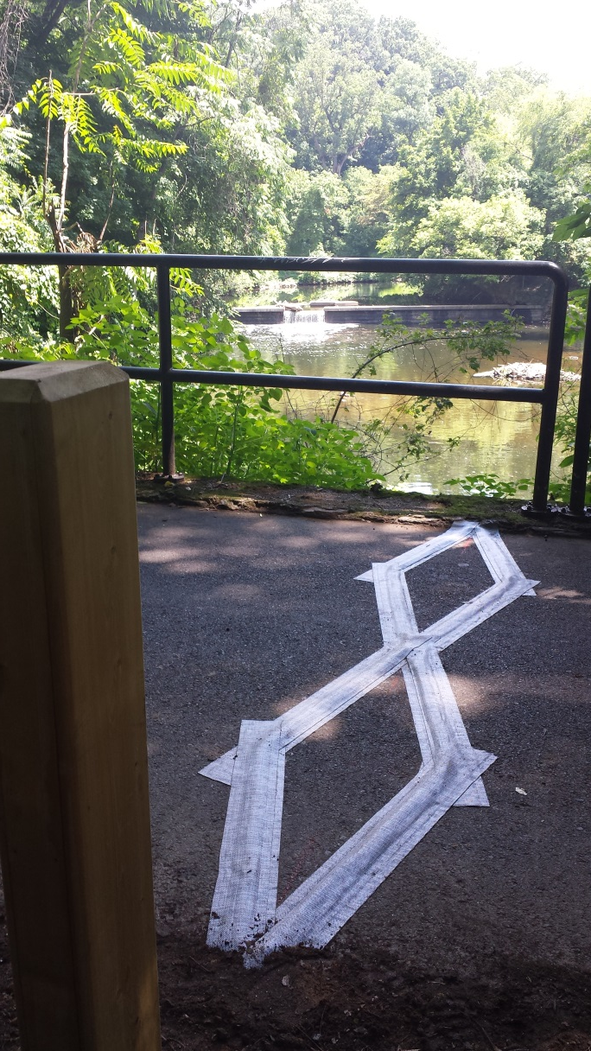
Questions?
Jonathan Ferullo
Senior Transportation Planner
Office of Travel Monitoring
jferullo@dvrpc.org
215.238.2883

