Slide 1
Transportation Satellite Accounts
U.S. Department of Transportation
Bureau of Transportation Statistics

Slide 2
Overview
The Transportation Satellite Accounts creates a comprehensive means for measuring the contribution of transportation services to the national economy.
Other national measures only explicitly show the value of transportation added by transportation industries
TSAs capture the value of transportation added by non-transportation industries and households

Slide 3
Transportation Satellite Accounts: Derivation
Extension to the input-output (I-O) accounts produced by the Bureau of Economic Analysis.
I-O accounts show the transportation value added by air, rail, water, truck, transit and ground passenger transportation, pipeline, other transportation and support activities, and warehousing and storage.
Known as for-hire transportation
TSAs add on to I-O accounts. Show value of air, rail, water, and truck transportation produced and used within non-transportation industries.
Known as in-house transportation
TSAs also show value of household’s contribution transportation via the depreciation of household vehicle(s)
Notes:
The TSAs show the value of transportation added by non-transportation industries by expanding upon the input-output account produced by the Bureau of Economic Analysis (BEA).
The I-O accounts, in their greatest detail, show the transportation value added by eight for-hire transportation industries. These industries provide transportation and transportation related services to industries and the public on a fee-basis. The TSAs add to the I-O accounts by showing the transportation produced and consumed internally by non-transportation industries during production. Transportation produced and consumed by a non-transportation industry for its own purpose is known as in-house transportation. The value of in-house rail, water, and truck transportation is extracted from the I-O accounts and shown explicitly in the TSAs along with all other values from the I-O accounts,
NOTES: A portion of in-house transportation is captured under for-hire transportation when it is provided by an establishment, owned and operated by a nontransportation enterprise, and large enough to be identified as a separate establishment producing primarily transportation services (e.g., fleet truck transportation owned by a grocery store chain to move food stuffs from distribution centers to local stores). Transportation provided by smaller scale establishments within nontransportation enterprises and transportation incidental to a business establishment (such as delivery service provided by a local furniture store) are not measured as transportation in the standard I-O accounts

Slide 4
Transportation Satellite Account: Components
Structure replicates I-O accounts. Includes:
Make table:
Shows the value of commodities produced by each industry.
Useful in seeing the:
Primary and secondary producers of commodities
Use table:
Shows the value of commodities used by each industry during production and the value each industry adds to gross domestic product (GDP).
Useful in finding the:
Amount of transportation used by an industry
Value added by transportation modes
Direct requirements table:
Value of commodities used by each industry during production as per dollar of industry output.
Useful in finding:
How important transportation is relative to other inputs
What industries rely the most on transportation
Notes:
The TSAs maintain the framework of the I-O accounts from which they are derived. So the TSAs contain the same tables as the I-O accounts. This includes a make, use, direct requirements, and total requirements table. I am going to describe the kind of information that can be acquired from the tables to measure the value of transportation.

Slide 5
Transportation Satellite Account: Components (cont.)
Commodity by commodity requirements table:
Value of inputs for each commodity required to deliver a dollar of the commodity to final users.
Useful in finding the:
Amount of transportation required to deliver a commodities to consumers
Industry by commodity total requirements table:
Value of inputs for each industry required to deliver a dollar of a given commodity to final users.
Useful in calculating the:
Amount of transportation required to meet a dollar increase in the demand for a commodity
Economic impact of transportation investments and economic impact of losses in transportation services
Notes:
The TSAs maintain the framework of the I-O accounts from which they are derived. So the TSAs contain the same tables as the I-O accounts. This includes a make, use, direct requirements, and total requirements table. I am going to describe the kind of information that can be acquired from the tables to measure the value of transportation.

Slide 6
Contribution of For-Hire and In-House Transportation to U.S. Gross Domestic Product (GDP) (2012)
Economic Activity
Contribution to GDP

Slide 7
Use of Transportation by Sector (2012)

Slide 8
Transportation Required Per Dollar of Sector Output (2012)

Slide 9
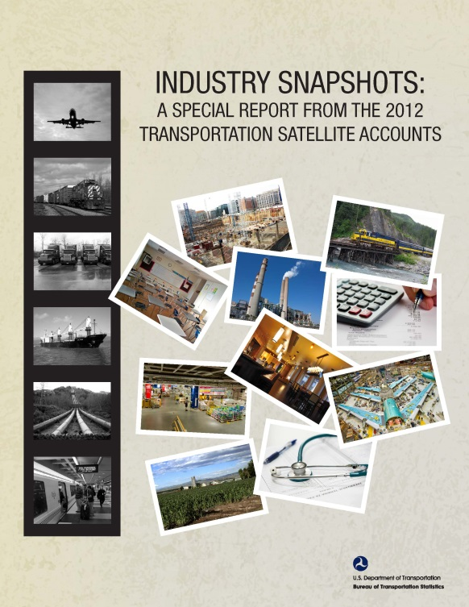
Data Availability
Detailed data available at:
http://www.rita.dot.gov/bts/sites/rita.dot.gov.bts/files/publications/transportation_satellite_accounts/index.html
The Industry Snapshots: A Special Report from the 2012 Transportation Satellite Accounts (forthcoming)
Shows the use of transportation by non-transportation industries

Slide 10
Contact Information
Theresa Firestine, Senior Economist
U.S. Department of Transportation, Bureau of Transportation Statistics
theresa.firestine@dot.gov
202-366-3629

